Slide 1
VMware

Slide 2
微軟股份有限公司

Slide 3
VMWARE
Notes:
Our vision is to empower people and organizations by radically simplifying IT through virtualization software.
By virtualizing computing—from the data center to the cloud to mobile devices—we help organizations become more agile, more responsive, and more profitable:
By finding new ways to solve complex IT problems, we empower you with the agility to leverage flexible infrastructure and automation, speeding delivery of new services to your organization.
With VMware’s virtualized infrastructure, you can respond quickly to the demands of today’s competitive, fast-changing environment. And all with an unprecedented degree of control over how you securely manage IT resources—without sacrificing choice, across any application, on any cloud, for any device.
The result goes straight to your bottom line. Driven by VMware software and solutions, the efficient use of hardware and human resources significantly reduces IT costs—both CapEx and OpEx—resulting in lower TCO than any competing offering, helping IT drive the profitability of your organization.

Slide 4
傳統個人PC維護管理遇到的挑戰
使用者經驗
預算
使用者資料備份
修正程式的更新
安控與認證
不同的作業系統
不同的工作地點
不同的工作型態
Task vs. knowledge worker
General vs. power user
Stationary vs. mobile user
OS
USERS
不同的工作裝置
使用者自己管理裝置
週邊設備的管制
DEVICES
APPS
多種應用程式的安裝
應用程式衝突
應用程式更新
桌面管理
資訊服務水平SLAs
快速部署個人作業環境
個人電腦的修復和汰換

Slide 5
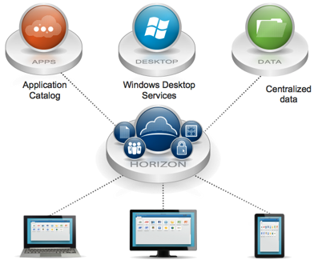
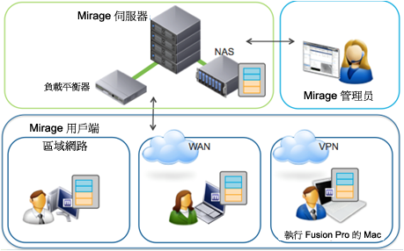
VMWare 產品系列簡介
伺服器虛擬化 與雲端基礎架構 vSphere
NEW
V5.2
虛擬化與伺服器 管理軟體 Vcenter Server
NEW
V4.2
桌面虛擬化平台 Horizon View
NEW
V5.2
強大的運算
可靠的安全性
網路服務
高效率儲存
一致的自動化
簡單的部署
主動式最佳化
集中化的控制及能見度
管理
將桌面平台與應用程式 虛擬化至資料中心
機敏資料保護
簡化與集中化管理
漫遊存取虛擬桌面平台
VMware
View Manager
VMware View
Composer
VMware View Clients
VMware ThinApp
Notes:
5

Slide 6
VMWare 產品系列價格簡介
伺服器虛擬化 與雲端基礎架構 vSphere
NEW
V5.2
虛擬化與伺服器 管理軟體 Vcenter Server
NEW
V4.2
桌面虛擬化平台 Horizon View
NEW
V5.2
強大的運算
可靠的安全性
網路服務
高效率儲存
一致的自動化
簡單的部署
主動式最佳化
集中化的控制及能見度
管理
將桌面平台與應用程式 虛擬化至資料中心
機敏資料保護
簡化與集中化管理
漫遊存取虛擬桌面平台
VMware
View Manager
VMware View
Composer
VMware View Clients
VMware ThinApp
Notes:
6

Slide 7
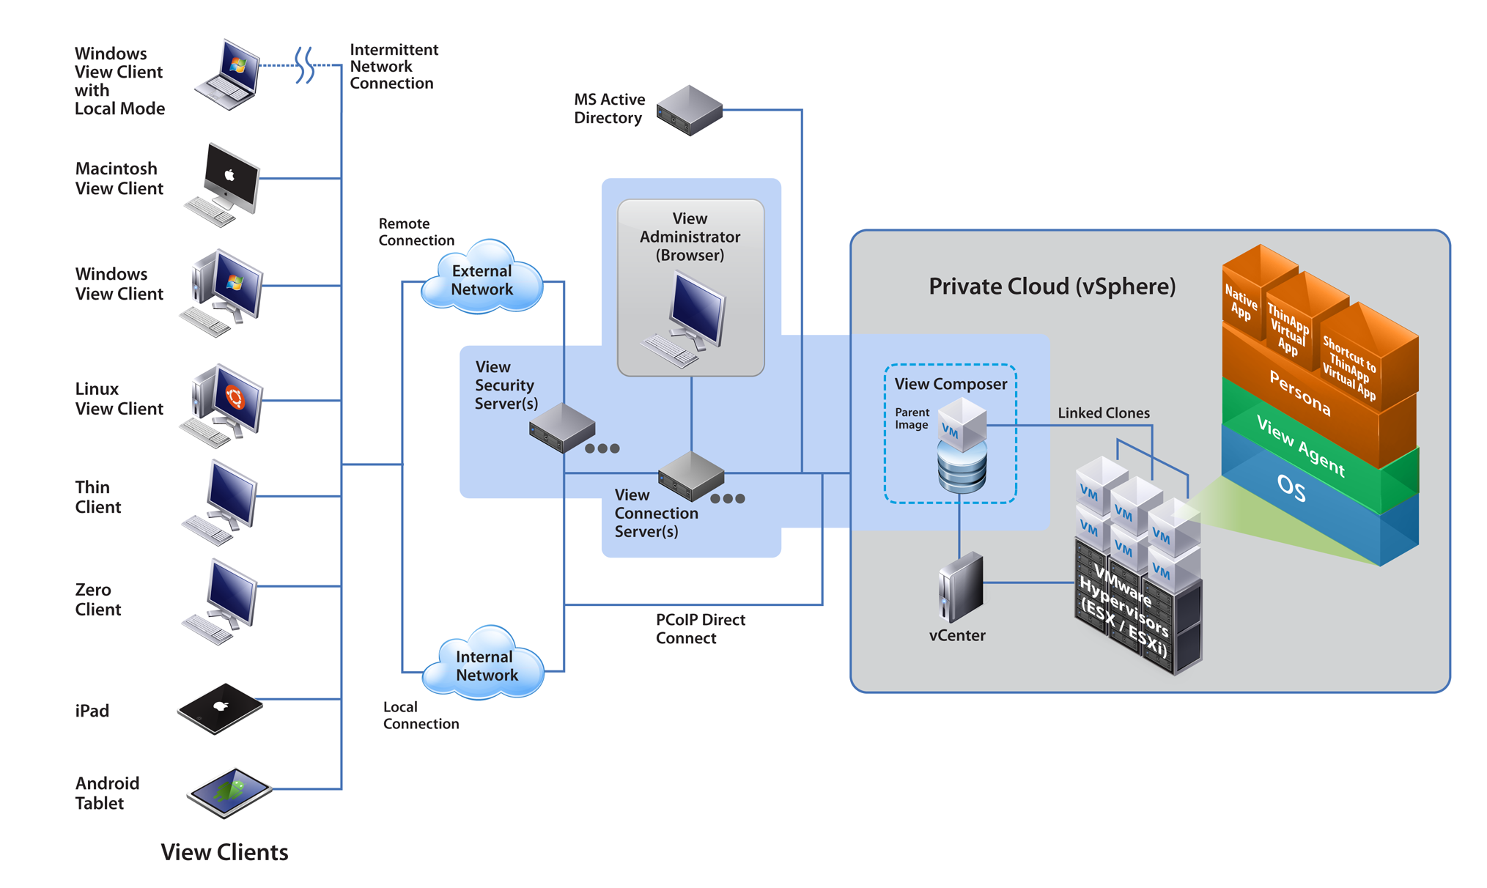
多樣化的終端支援
高可靠度與安全的虛擬計算環境
簡易的構件安裝與管理介面
OS / AP / 用戶資料的解構與管理
高效能的傳輸協定

Slide 8
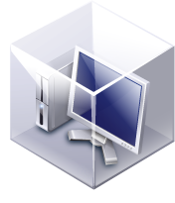

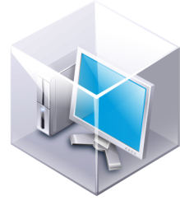

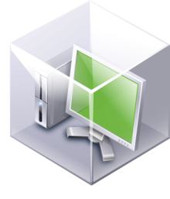

專用桌面
共享桌面
虛擬桌面
使用者
虛擬桌面
使用者
為每個用戶創建一個桌面
每次用戶訪問相同的桌面
桌面的用戶數和數量的不同
用戶連接到有空置的桌面

Slide 9


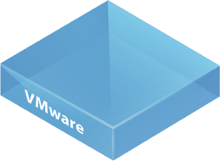
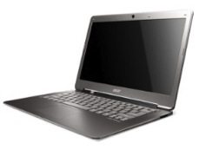




Horizon View：集中管理、安全保護
管理集中化虛擬桌面平台
安全性與合規
商業靈活性
節省營運成本
隨處存取
行動裝置及攜帶自有 裝置 (BYOD) 存取
高效率遠端通訊協定
使用者可從各種裝置進行遠端存取

Slide 10
HYPER-V
Notes:
Our vision is to empower people and organizations by radically simplifying IT through virtualization software.
By virtualizing computing—from the data center to the cloud to mobile devices—we help organizations become more agile, more responsive, and more profitable:
By finding new ways to solve complex IT problems, we empower you with the agility to leverage flexible infrastructure and automation, speeding delivery of new services to your organization.
With VMware’s virtualized infrastructure, you can respond quickly to the demands of today’s competitive, fast-changing environment. And all with an unprecedented degree of control over how you securely manage IT resources—without sacrificing choice, across any application, on any cloud, for any device.
The result goes straight to your bottom line. Driven by VMware software and solutions, the efficient use of hardware and human resources significantly reduces IT costs—both CapEx and OpEx—resulting in lower TCO than any competing offering, helping IT drive the profitability of your organization.

Slide 11
Windows Server 2012 300項以上的新功能
Teaming, Consistent Device Naming, IPSec task offloading, NTFS Online corruption repair, Storage Spaces, ReFS, SMS Direct, SMB Multichannel, SQL over SMB, Cluster Transparent Failover, Hyper-V over SMB, Continuous Availability NFS, Continuous Availability iSCSI, Hyper-V Virtual Fiber Channel, Hyper-V Replica, Offload File Transfer, iSCSI Software Target, Thin Provisioning, Data Deduplication, DHCP Failover, Cluster-aware Updating, Online Backup, Hyper-V Cluster scale out & scale up, VM Mobility, SR-IOV, D-VMQs, DNSSEC, Ressource Metering, IPAM, NIC Offload, PowerShell – more than 2300 CmdLets, Server Manager, Hyper-V Extensible Switch, Network Virtualization, RDP WAN Optimization, IIS 8.0, Branch Office enhancement, Multiserver Management, Multitenant security & isolation, PVLAN, DHCP guard protection, Virtual port ACLs, Reliably import virtual machines, Online merge snapshots, Hyper-V host scale and scale-up, New virtual hard disk format, Support for 4-KB disk sectors in Hyper-V virtual disks, Data Center Bridging (DCB), NUMA support, QoS, Encrypted cluster volumes, Hyper-V application monitoring, Virtual machine failover prioritization, Affinity (and anti-affinity) virtual machine rules, Hyper-V simultaneous live migration, RemoteFX, Hyper-V Online Meta Operations, Resource Pools, CSV Block Cache, ….

Slide 12
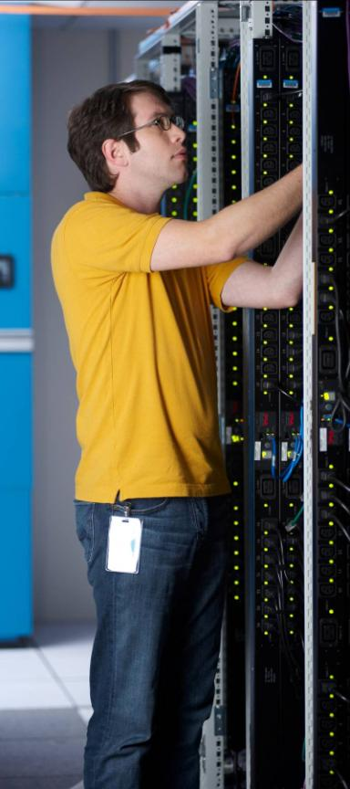

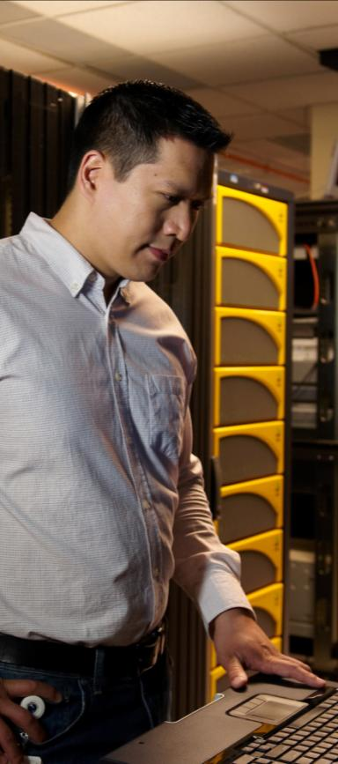







Beyond on
超越虛擬化
簡化大量伺服器管理
從APP到雲端
啟動全新工作模式
Notes:
Optimize your IT for the cloud with Windows Server 2012
When you optimize your IT for the cloud with Windows Server 2012 RC, you take advantage of the skills and investment you’ve already made in building a familiar and consistent platform. Windows Server 2012 RC builds on that familiarity and optimizes your IT for the cloud. With Windows Server 2012 RC, you gain all the Microsoft experience behind building and operating private and public clouds, delivered as a dynamic, available, and cost-effective server platform.
Windows Server 2012 RC delivers value in four key ways:
It takes you beyond virtualization. Windows Server 2012 RC offers a dynamic, multitenant infrastructure that goes beyond virtualization technology to a complete platform for building a private cloud.
It delivers the power of many servers, with the simplicity of one. Windows Server 2012 RC offers you excellent economics by integrating a highly available and easy-to-manage multiple-server platform.
It opens the door to every app on any cloud. Windows Server 2012 RC is the broadest, most scalable and elastic web and application platform, giving you the flexibility to build and deploy applications on-premises, in the cloud, and in a hybrid environment using a consistent set of tools and frameworks.
It enables the modern work style. Windows Server 2012 RC empowers IT to provide users with flexible access to data and applications anywhere, on any device, while simplifying management and maintaining security, control, and compliance.
Let’s look at each of these areas in more detail.

Slide 13






with Windows Server 2012 RC – 為雲端平台而生
重新聚焦在安全可擴充的workloads, 有效率的建立您的第一朵私有雲, 並提供安全的雲端連結.
超越虛擬化
簡化大量伺服器管理
有效管理底層架構, 最大化使用時間\最小化停機時間
從APP到雲端
提供開放且可延伸的平台並可支援跨私有\公有雲的應用程式
啟動全新工作模式
支援有彈性的行動工作模式
Notes:
Optimized your IT for the cloud with Windows Server 2012 RC
We’ve just spent some time learning about the features in Windows Server 2012 RC that help you optimize your IT for the cloud. To summarize, Windows Server 2012 RC helps you:
Scale and secure workloads, cost-effectively build a private cloud, and securely connect to cloud services
Efficiently manage infrastructure while maximizing uptime and minimizing failures and downtime
Build on an open and scalable web platform that supports applications across premises
Support a mobile and flexible work style that gives people access to information and data, regardless of the infrastructure, network, device, or application used to access it

Slide 14
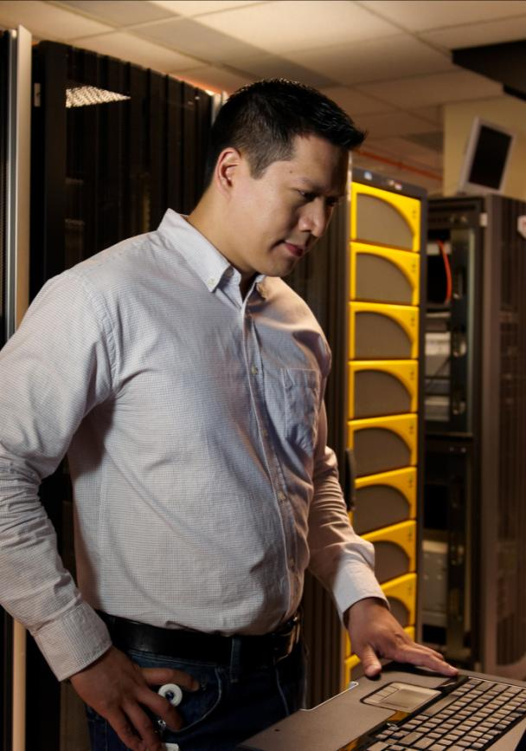

Business drivers
佈署彈性動態的底層架構
有品質的資料保護與管理機制
成本效應最佳化
產生新的營利模式，創造利潤
超越虛擬化
Notes:
Beyond virtualization
We understand the demands being placed on IT to deliver business applications and user experiences that help you grow and scale the business. In any dynamic environment, you need to be able to:
Create an environment that can adapt dynamically
Provide high performance and scale based on the needs of the business
Guarantee the right level of SLA and provide chargebacks
Automate systems through a management system that can enforce policies for data security
Reduce the overall costs of your infrastructure
Create new sources of revenue, especially for hosting providers

Slide 15



建立並提供私有雲服務，並可以安全的與公有雲服務連接
全面的虛擬化平台
優秀的擴充性與效能
超越虛擬化
與雲端服務無縫銜接
Notes:
Windows Server 2012 RC offers a dynamic, multitenant infrastructure that goes beyond virtualization to provide maximum flexibility for delivering and connecting to cloud services.
You already use virtualization technology to consolidate servers and reduce costs. Next, you need to be able to secure and scale your virtualized services—to go beyond virtualization. Windows Server 2012 RC takes your virtualization infrastructure to that next level. Hyper-V in Windows Server 2012 RC builds on a complete virtualization platform to provide the building blocks of a private cloud, offering secure multitenancy, flexible resource placement, enormous scalability, and cross-premises reliability for hosted services.
Do you need to isolate virtual servers or networks that belong to different customers or departments, regardless of where these resources are located in your data center? Now you can.
Do you need to move running virtual machines from one physical server to another with no downtime—inside or outside clusters? Windows Server 2012 RC lets you do that, too.
How about virtualizing your most critical, resource-intensive workloads? Or configuring offsite server replicas to keep services running after a catastrophic failure? Both are now possible.

Slide 16
全面的虛擬化平台
Delivering a fully isolated, multitenant environment that includes tools to guarantee SLAs, enable chargebacks, and support self-service delivery
多租戶安全性與有效隔離
提高機敏性並最小化停機時間
提高服務品質(Quality of service)
提供輔助決策資訊以建立私有雲服務層級並提升主動擴充能力的相關資訊
超越虛擬化
Notes:
Complete virtualization platform
Windows Server 2012 RC delivers a dynamic data center and cloud infrastructure where workloads, networks, and storage become more flexible, policy-based resources—to increase agility while minimizing downtime.
Key features include the following:
Multitenant security and isolation. With the shift to shared off-premises Internet as a service (IaaS) solutions, maintaining network isolation between the various tenants or customers is a difficult requirement. With Windows Server 2012 RC, you can configure servers running Hyper‑V to enforce network isolation among any set of arbitrary isolation groups, which are typically defined for individual customers or sets of workloads.
Scale beyond VLANs with Hyper-V Network virtualization. Isolating virtual machines from different departments or customers can be a challenge on a shared network. When these departments or customers need to isolate entire networks of virtual machines, the challenge becomes even greater. Traditionally, VLANs are used to isolate networks, but VLANs become very complex to manage on a large scale. Hyper-V network virtualization solves this problem. By using this feature, you can isolate network traffic from different business units or customers on a shared infrastructure without using VLANs. Hyper-V network virtualization also lets you move virtual machines as needed within your virtual infrastructure while preserving their virtual network assignments. Finally, you can even use Hyper-V network virtualization to transparently integrate these private networks into a pre-existing infrastructure on another site.
Quality of service. You need to ensure everyone gets a fair share of the network channel to your data center. Windows Server 2012 RC expands the power of quality of service (QoS) by introducing the ability to guarantee a minimum bandwidth to a virtual machine or service. This feature is important for hosting companies who need to honor service-level agreement (SLA) clauses that promise a minimum network bandwidth to customers. It’s equally important to enterprises that need to have predictable network performance when they run virtualized server workloads on shared hardware.

Slide 17
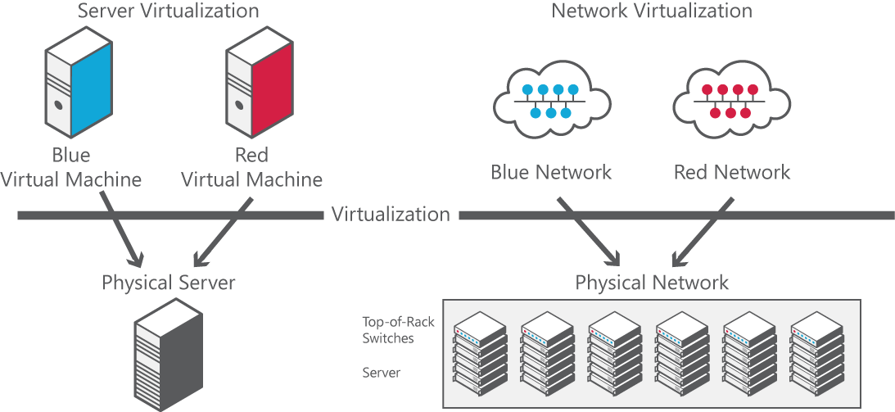
對應功能
Offers numerous benefits with virtual machine placement functionality
Removes VLAN constraints
Eliminates hierarchical IP address assignment for virtual machines
網路虛擬化，提供更佳的安全性與彈性．
Network Virtualization isolating network traffic that belongs to two customers
Notes:
Isolating the virtual machines of different departments or customers can be a challenge on a shared network. When these departments or customers must isolate entire networks of virtual machines, the challenge becomes even greater. Traditionally, VLANs are used to isolate networks, but VLANs are very complex to manage on a large scale. The following are the primary drawbacks of VLANs:
Cumbersome reconfiguration of production switches is required whenever virtual machines or isolation boundaries must be moved, and the frequent reconfiguration of the physical network to add or modify VLANs increases the risk of an unplanned loss of service.
VLANs have limited scalability because typical switches support only 1,000 VLAN IDs (with a maximum of 4,095).
VLANs cannot span multiple subnets, which limits the number of nodes in a single VLAN and restricts the placement of virtual machines based on physical location.
In addition to the drawbacks of VLANs, virtual machine IP address assignment presents other key issues when organizations move to the cloud:
Required renumbering of service workloads.
Policies that are tied to IP addresses.
Physical locations that determine virtual machine IP addresses.
Topological dependency of virtual machine deployment and traffic isolation.
Unfortunately, when IP addresses are moved to the cloud, the addresses must be changed to accommodate the physical and topological restrictions of the data center. Renumbering IP addresses is cumbersome because the associated policies that are based on the IP addresses must also be updated.
The physical layout of a data center influences the permissible potential IP addresses for virtual machines that run on a specific server or blade server that is connected to a specific rack in the data center. A virtual machine that is provisioned and placed in the data center must adhere to the choices and restrictions regarding its IP address.
Therefore, the typical result is that data center administrators assign IP addresses to the virtual machines and force virtual machine owners to adjust their policies that were based on the original IP address. This renumbering overhead is so high that many enterprises choose to deploy only new services into the cloud and leave legacy applications unchanged.
Hyper‑V Network Virtualization solves these problems. With this feature, you can isolate network traffic from different business units or customers on a shared infrastructure and not be required to use VLANs. Hyper‑V Network Virtualization also lets you move virtual machines as needed within your virtual infrastructure while preserving their virtual network assignments. Finally, you can even use Hyper‑V Network Virtualization to transparently integrate these private networks into a preexisting infrastructure on another site.
Hyper‑V Network Virtualization extends the concept of server virtualization to allow multiple virtual networks, potentially with overlapping IP addresses, to be deployed on the same physical network. With Hyper‑V Network Virtualization, you can set policies that isolate traffic in your dedicated virtual network independently of the physical infrastructure.
The figure illustrates how Hyper‑V Network Virtualization isolates network traffic belonging to two different customers. In it, Blue and Red virtual machines are hosted on a single physical network, or even on the same physical server. However, because they belong to separate Blue and Red virtual networks, the virtual machines can’t communicate with each other even if the customers assign them IP addresses from the same address space.
Server Virtualization is a well-understood concept that allows multiple server instances to run on a single physical host concurrently, but isolated from each other, with each server instance essentially acting as if it’s the only one running on the physical machine.
Network Virtualization provides a similar capability. On the same physical network:
You can run multiple virtual network infrastructures.
You can have overlapping IP addresses.
Each virtual network infrastructure acts as if it’s the only one running on the shared physical network infrastructure.
Problems solved
Network virtualization solves earlier problems by:
Removing VLAN constraints.
Eliminating hierarchical IP address assignment for virtual machines.

Slide 18
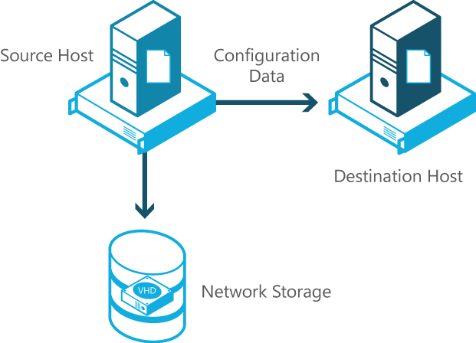
對應功能
Promotes a faster and easier process using new and enhanced live migration features
Supports higher network bandwidths (up to 10 GB per second)
虛擬機器Live Migration效率提升
Live migration setup with Hyper-V in Windows Server 2012 RC
Notes:
Hyper‑V in Windows Server 2012 RC dramatically increases the levels of mobility and flexibility in private clouds by increasing the speed of live migrations, which in turn supports the simultaneous migration of many virtual machines in a cluster. It also supports live migration outside of a clustered environment.
Hyper‑V live migration moves running virtual machines from one physical host to another with no impact on virtual machine availability to users. Live migration copies the memory of the migrating virtual machine to the destination host prior to migration. This minimizes the transfer time of the virtual machine. During a live migration, the administrator—or script—that initiates the live migration determines which computer will be used as the destination for the live migration. For their guest operating system, there is minimal impact and no need for a specific configuration.
As shown in the diagram, during a live migration setup, the source host creates a TCP connection with the destination host. This connection transfers the virtual machine configuration data to the destination host. A skeleton virtual machine is set up on the destination host, and memory is allocated to the destination virtual machine.
Key features of the new live migration capability include:
The use of higher network bandwidths—up to 10 GB—to complete migrations faster in clustered environments.
Live migrations that can be performed outside of clustered environments using server message block (SMB) file shares.
The ability of administrators to perform a live migration of a virtual machine between two stand-alone Hyper‑V hosts when using local storage for the virtual machine.
Multiple simultaneous live migrations

Slide 19
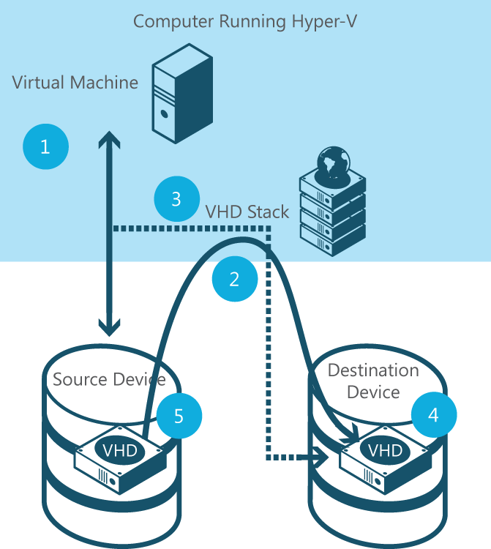
對應功能
Virtual machine storage now can be moved with minimal downtime.
Administrators can add storage as a stand-alone system or as part of a Hyper-V® cluster.
線上跨儲存媒體進行虛擬機器遷徙，減少停機
Using Hyper-V to easily move virtual machine storage from one virtual hard disk (VHD) to another
Notes:
Updating the physical storage available to Hyper‑V is the most common reason for moving a virtual machine’s storage. In the past, administrators could move a running instance of a virtual machine using live migration—but they could not move the virtual machine’s storage while the virtual machine was running. The task required downtime.
Hyper‑V in Windows Server 2012 RC addresses this issue with new support for moving virtual machine storage—while the virtual machine is running—with minimal downtime. Administrators can add storage either as a stand-alone system or to a Hyper-V cluster, and then move virtual machines to the new storage while the virtual machines continue to run.
This is called Storage Live Migration
When you move a running virtual machine’s virtual hard disks, Hyper‑V performs the following steps to move storage:
Throughout most of the move operation, disk reads and writes go to the source virtual hard disk.
While reads and writes occur on the source virtual hard disk, the disk contents are copied to the new destination virtual hard disk.
After the initial disk copy is complete, disk writes are mirrored to both the source and destination virtual hard disks while outstanding disk changes are replicated.
After the source and destination virtual hard disks are synchronized, the virtual machine switches over to using the destination virtual hard disk.
The source virtual hard disk is deleted.

Slide 20
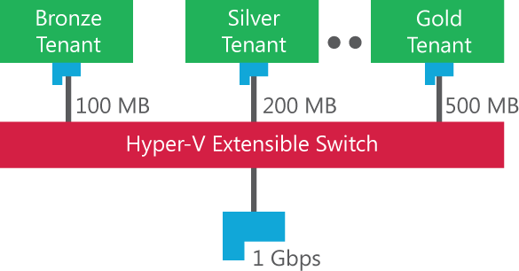
對應功能
New Quality of Service (QoS) features:
Provide greater functionality and management tools for improved performance
Offer two mechanisms to support bandwidth performance
Take server consolidation and network convergence to new levels
Strict minimum bandwidth example
加強服務品質管控( QoS)
Notes:
As organizations move from 1-gigabit to 10-gigabit network adapters on servers, it becomes increasingly important to converge all types of network traffic onto a single network adapter while maintaining performance isolation for each one.
The new Quality of Service (QoS) feature in Windows Server 2012 RC helps to meet the requirements of most converged network deployment scenarios. QoS provides new functionality and management interfaces in addition to what is available with Windows Server 2008 R2, helping organizations take server consolidation and network convergence in data centers and large enterprises to a new level.
Windows Server 2012 RC offers two different mechanisms to enforce minimum bandwidth: one is through the newly enhanced packet scheduler in Windows, and the other is through network adapters that support Data Center Bridging (DCB). Each has its own distinct advantages:
The software solution, which is built on the new packet scheduler in Windows Server 2012 RC, provides a fine granularity of classification. It is the only viable choice if there are many traffic flows that require minimum bandwidth enforcement.
The hardware solution, which depends on DCB support on the network adapter, supports fewer traffic flows, but it can classify network traffic that does not originate from the networking stack.
Both mechanisms can be employed on the same server. The QoS also takes advantage of new DCB-capable network adapter hardware supported by Windows ecosystem partners to complement the software functionality.

Slide 21
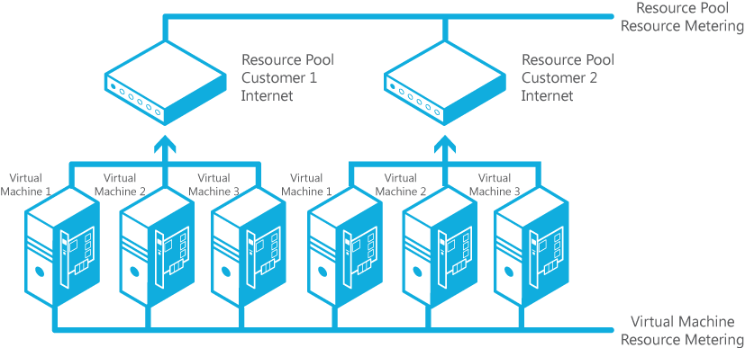
對應功能
New Resource Metering:
Provides accurate, reliable methods for measuring usage
Collects a wide range of data, including CPU, memory, bandwidth consumed, and disk space
Aggregation of resource use data through resource pools Resource Metering
導入資源使用率計量機制
Notes:
IT organizations need tools to charge back business units that they support, while providing guarantees that the business units will get the right amount of resources to match their needs.
For hosting providers, it is equally important to issue chargebacks based on the amount of usage generated by each customer.
To assist with more accurate, streamlined chargebacks while protecting historical information, Hyper‑V in Windows Server 2012 RC introduces Resource Metering. This feature allows customers to create cost-effective, usage-based billing solutions. Enterprise IT organizations and hosting providers can simply choose the best billing strategy for their business model, and independent software vendors can develop more reliable end-to-end chargeback solutions on top of Hyper‑V.
Resource Metering, which reveals individual virtual machine usage through resource pools, works with all Hyper‑V operations. The movement of virtual machines between Hyper‑V hosts—for example, through live, offline, or storage migrations—does not affect the collected data.
Information that can be captured includes:
Average CPU usage.
Average physical memory usage, measured in megabytes.
Minimum memory usage (lowest amount of physical memory).
Maximum memory usage (highest amount of physical memory).
Maximum amount of disk space allocated to a virtual machine.
Total incoming network traffic, measured in megabytes, for a virtual network adapter.
Total outgoing network traffic, measured in megabytes, for a virtual network adapter.
The Resource Metering feature in Windows Server 2012 RC Hyper‑V makes it easier for you to track historical data about each customer’s use of virtual machines. Through resource pools, which are part of this technology, Hyper‑V lets providers aggregate use data in a multitenant environment, in which different customers or business units may have many virtual machines. With this feature, you can perform capacity planning or monitor resource consumption by various business units or customers. Third-party ISVs can use data that this feature provides to build more reliable, end-to-end chargeback solutions.

Slide 22
優秀的擴充性與效能
Delivering a high-density, scalable environment that can be adapted to perform at the optimal level based on customer needs
提高Hyper-V host 乘載量與效能最佳化
Hyper-V 可以提供Virtual Fiber Channel
Hyper-V 提供Offloaded data transfer (ODX) 儲存整合功能
透過Windows Server 2012 可以降低虛擬化所需的儲存成本
超越虛擬化
Notes:
Increased scalability and performance
Windows Server 2012 RC delivers a high-density, scalable environment that can be adapted to perform at the optimal level based on customer needs. It allows a fixed amount of resources to run more workloads faster with Hyper-V and through processing offload to hardware.
Key features include the following:
Hyper-V host scale and scale-up workload support. You need the freedom to scale your virtualized services. Hyper-V in Windows Server 2012 RC greatly expands support for host processors and memory. These features help ensure your virtualization infrastructure can support the configuration of large, high-performance virtual machines to support workloads that might need to scale up significantly. Scale Hyper-V hosts up to 320 logical processors and 4 terabytes of memory; scale guests up to 64 virtual processors and 1 TB of memory (all numbers based on RC release)
Offloaded data transfer support in Hyper-V. The speed of your virtualization platform should rival that of physical hardware whenever possible. With offloaded data transfer (ODX) support in Hyper-V, you can now achieve such native-like performance when your virtual machines read from and write to storage
Virtual Fiber Channel support in Hyper-V. You need your virtualized workloads to connect to your existing storage arrays without any trouble. Windows Server 2012 RC provides Fiber Channel ports within the guest operating system, allowing you to connect to Fiber Channel directly from within virtual machines. This feature protects your investments in Fiber Channel, lets you virtualize workloads that use direct access to Fiber Channel storage, lets you cluster guest operating systems over Fiber Channel, and offers an important new storage option for servers hosted in your virtualization infrastructure.

Slide 23
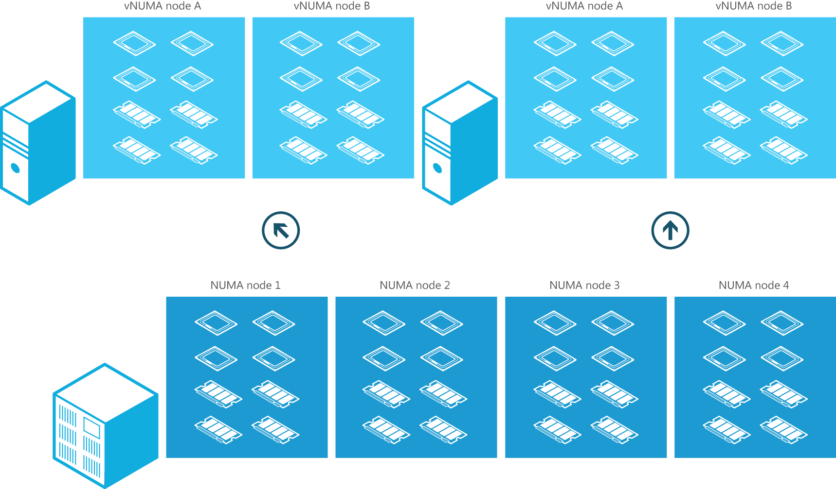
對應功能
Projects NUMA topology onto a virtual machine
Allows guest operating systems and applications to make intelligent NUMA decisions
Aligns guest NUMA nodes with host resources
NUMA 支援，硬體技術完全整合
Guest NUMA topology matching host NUMA topology (by default)
Notes:
What is NUMA?
NUMA, or Non-Uniform Memory Access, refers to a computer architecture in multiprocessor systems in which the time required for a processor to access memory depends on the memory’s location relative to the processor. With NUMA, a processor can access local memory (memory attached directly to the processor) faster than it can access remote memory (memory that is local to another processor in the system). Modern operating systems and high-performance applications such as SQL Server have developed optimizations to recognize the system’s NUMA topology and consider NUMA when they schedule threads or allocate memory to increase performance.
Guest NUMA
Projecting a virtual NUMA topology onto a virtual machine provides optimal performance and workload scalability in large virtual machine configurations. It does this by allowing the guest operating system and applications such as SQL Server to take advantage of their inherent NUMA performance optimizations (for example, making intelligent NUMA decisions about thread and memory allocation). The default virtual NUMA topology projected into a virtual machine running Hyper‑V is optimized to match the host’s NUMA topology, as shown in the figure.

Slide 24
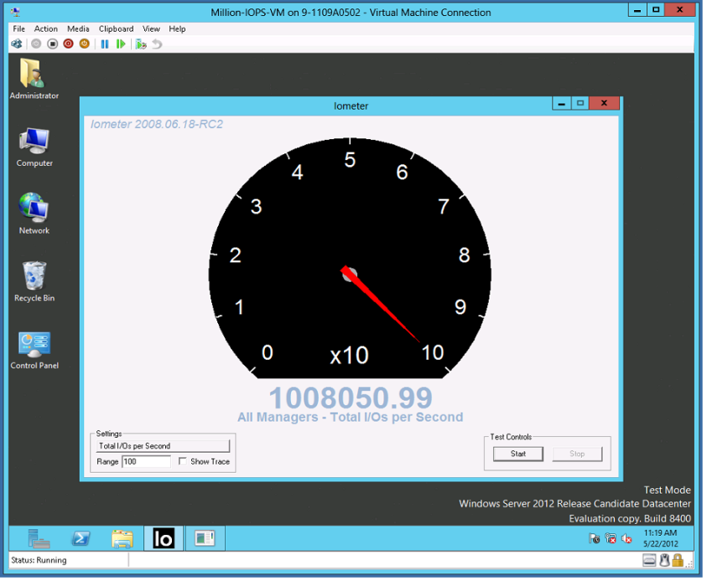
Hyper-V: Over 1 Millions IOPs from a Single VM
Industry Leading IO Performance
VM storage performance on par with native
Performance scales linearly with increase in virtual processors
Windows Server 2012 Hyper-V can virtualize over 99% of the world’s SQL Server.
Windows Server 2008 R2 | VMware vSphere 5 | Windows Server 2012
250,000 IOPs | 300,000 IOPs | 1,000,000+ IOPs

Slide 25
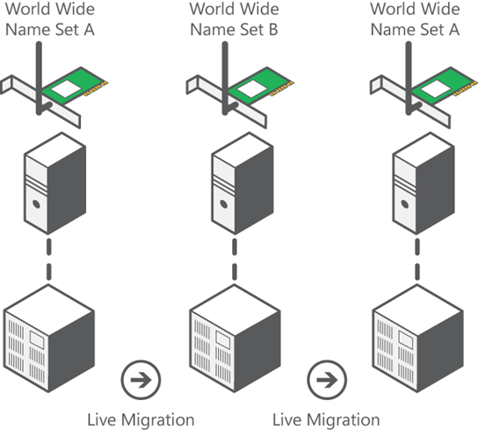
對應功能
Hyper-V supports Fibre Channel storage area networks (SANs):
Connects virtual machines directly to Fibre Channel SANs
Allows up to four virtual Fibre Channel adapters on a virtual machine
Hyper-V 虛擬光纖卡，與既有底層架構無縫整合
Live Migration maintaining Fibre Channel connectivity
Notes:
Hyper‑V in Windows Server 2012 RC has a new Fibre Channel support feature that gives organizations more options for growth. The feature takes advantage of Fibre Channel storage area networks (SANs). This allows administrators to connect virtual machines directly to Fibre Channel-based storage. The feature also introduces Fibre Channel host bus adapter ports in the guest operating system that runs the virtual machine.
Virtual Fibre Channel for Hyper‑V uses a World Wide Name (WWN) that is associated with a virtual machine, which provides the guest operating system with unfiltered access to a SAN. The virtual Fibre Channel presents an alternate, hardware-based I/O path to the Windows software virtual hard disk stack, giving administrators the option to use the advanced functionality offered by their SANs directly from Hyper‑V virtual machines.
Virtual Fibre Channel connects WWNs directly to virtual machines, which removes dependencies on the host WWNs and hardware configuration. Hyper‑V users can now migrate virtual machines between different Hyper‑V hosts while using existing SAN recommended practices with the virtual machines.
The technology also supports live migration of virtual machines connected to the Fibre Channel SAN.

Slide 26
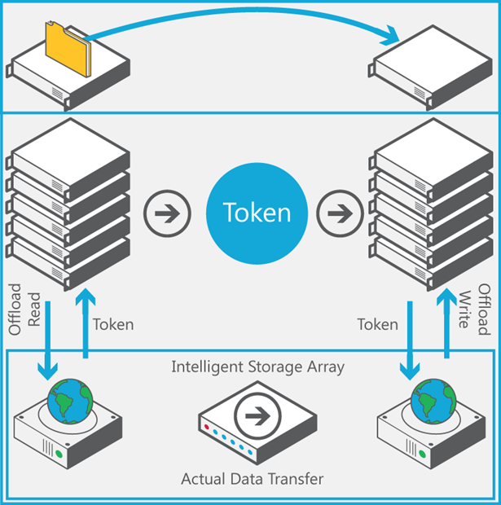
對應功能
Rapid virtual machine provisioning and migration
Faster transfers on large files
Latency minimization
Less CPU and network usage
Hyper-V 儲存整合功能
Offline Data Transfer (ODX)
Token-based copy operation
Notes:
Hyper‑V in Windows Server 2012 RC introduces Copy Offload support, which takes advantage of new developments in hardware storage that provide fast copying of large amounts of data. Hyper‑V performs these operations faster than was previously possible.
With this new feature, Hyper‑V workloads use the offload semantics of the host hardware, as well as the virtual storage stack, to perform internal operations on virtual hard disks that require large amounts of data to be copied. The hardware is connected to the virtual machine as virtual SCSI devices or else is directly attached.
By offloading support, Hyper-V Copy Offload allows CPU resources to be used for the processing needs of the application rather than being diluted by the demands of networking and storage overheads. This, in turn, allows IT organizations to take advantage of new SAN copy offload innovations that allow for copying large amounts of data from one location to another.

Slide 27
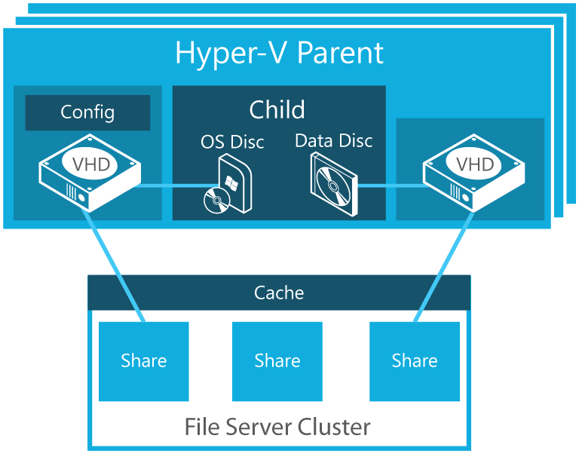
對應功能
New Hyper-V storage option:
Supports Server Message Block 3.0 (SMB3) remote file storage
Can be used in single-node, dual-node, and multi-node file server configurations
Provides more flexibility and greater ease of storage provisioning for virtual environments
Hyper-V 儲存整合功能
Hyper-V over SMB3
Hyper-V now can store virtual machine files (including configuration, VHD files, and snapshots) in shared folders that use the SMB3 protocol.
Notes:
Hyper‑V in Windows Server 2012 RC introduces a new storage option—support for Server Message Block 3.0 (SMB3) remote file storage.
SMB is an application-layer network protocol that provides shared access to files, printers, ports, and other types of communications between nodes on a network.
With the new Hyper‑V support for SMB3 file storage, it is easier for administrators to access various storage options for virtualized environments.
The SMB3 remote file storage can be set up in several different configurations, including:
Single-node file server, which provides the lowest cost for shared storage.
Dual-node file server, which has a low cost and provides limited scalability.
Multinode file server, which has the highest cost but also provides the highest scalability, taking advantage of potentially thousands of disks.
This capability provides increased flexibility, greater ease of storage provisioning, and reduced system cost when compared to the storage options in prior versions of Windows Server.

Slide 28
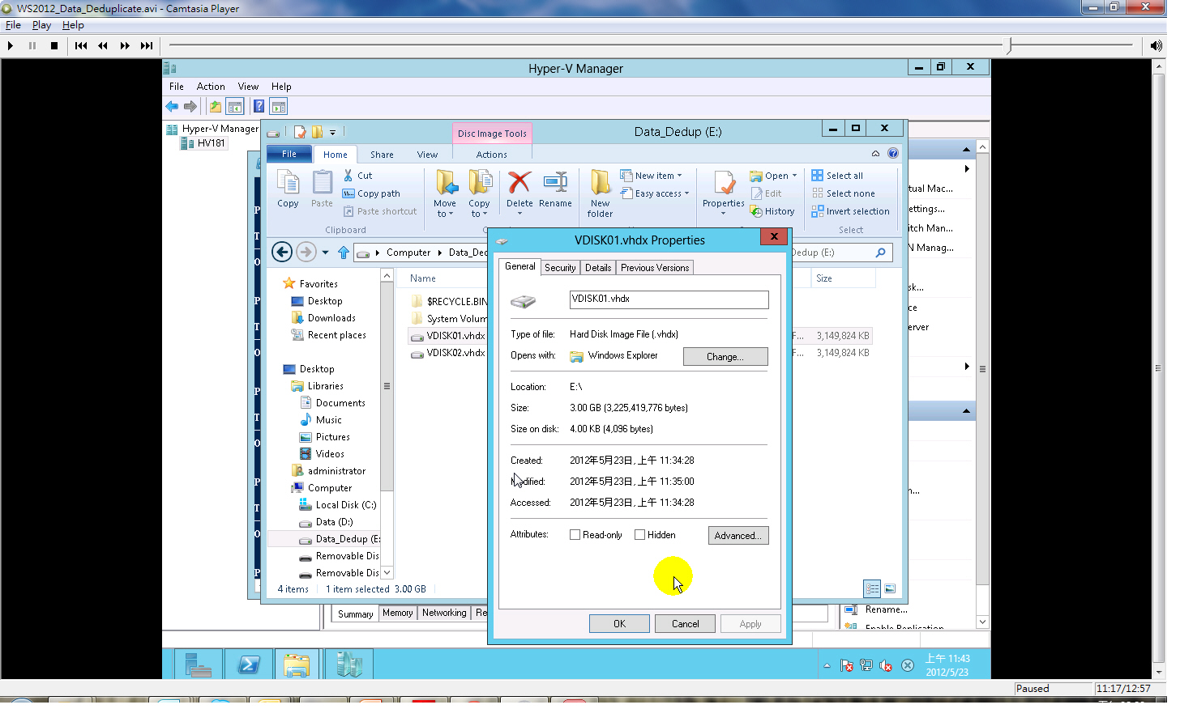
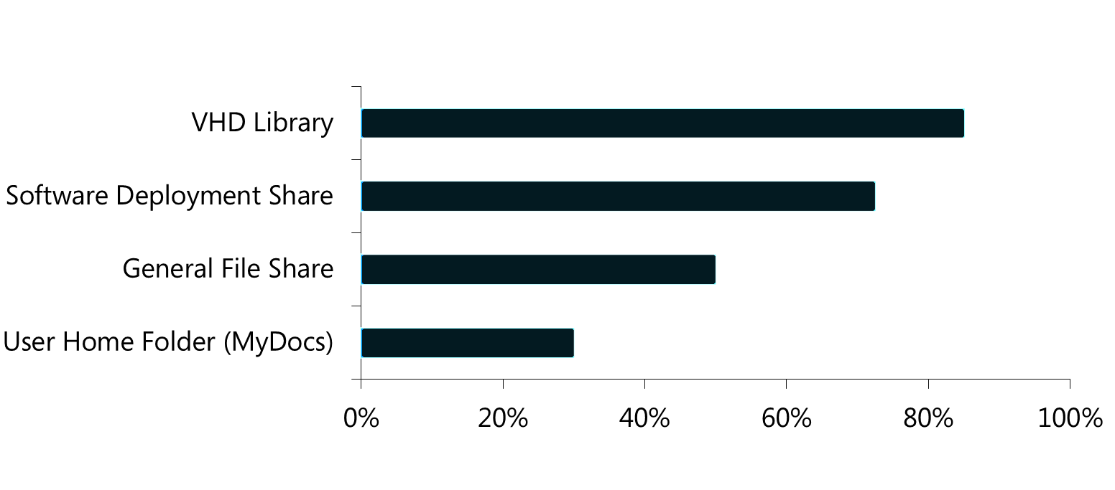
對應功能
Average savings with Data Deduplication by workload type
最佳化儲存空間
2:1 with File Shares
20:1 with Virtual Storage
延展性與效能
Low CPU and memory impact
Configured scheduling
資料重複技術，最大化既有儲存投資
可靠度與整合性
Checksums and integrity checks
整合BranchCache機制，提供好的效能
Notes:
Hyper‑V in Windows Server 2012 RC introduces Copy Offload support, which takes advantage of new developments in hardware storage that provide fast copying of large amounts of data. Hyper‑V performs these operations faster than was previously possible.
With this new feature, Hyper‑V workloads use the offload semantics of the host hardware, as well as the virtual storage stack, to perform internal operations on virtual hard disks that require large amounts of data to be copied. The hardware is connected to the virtual machine as virtual SCSI devices or else is directly attached.
By offloading support, Hyper-V Copy Offload allows CPU resources to be used for the processing needs of the application rather than being diluted by the demands of networking and storage overheads. This, in turn, allows IT organizations to take advantage of new SAN copy offload innovations that allow for copying large amounts of data from one location to another.

Slide 29
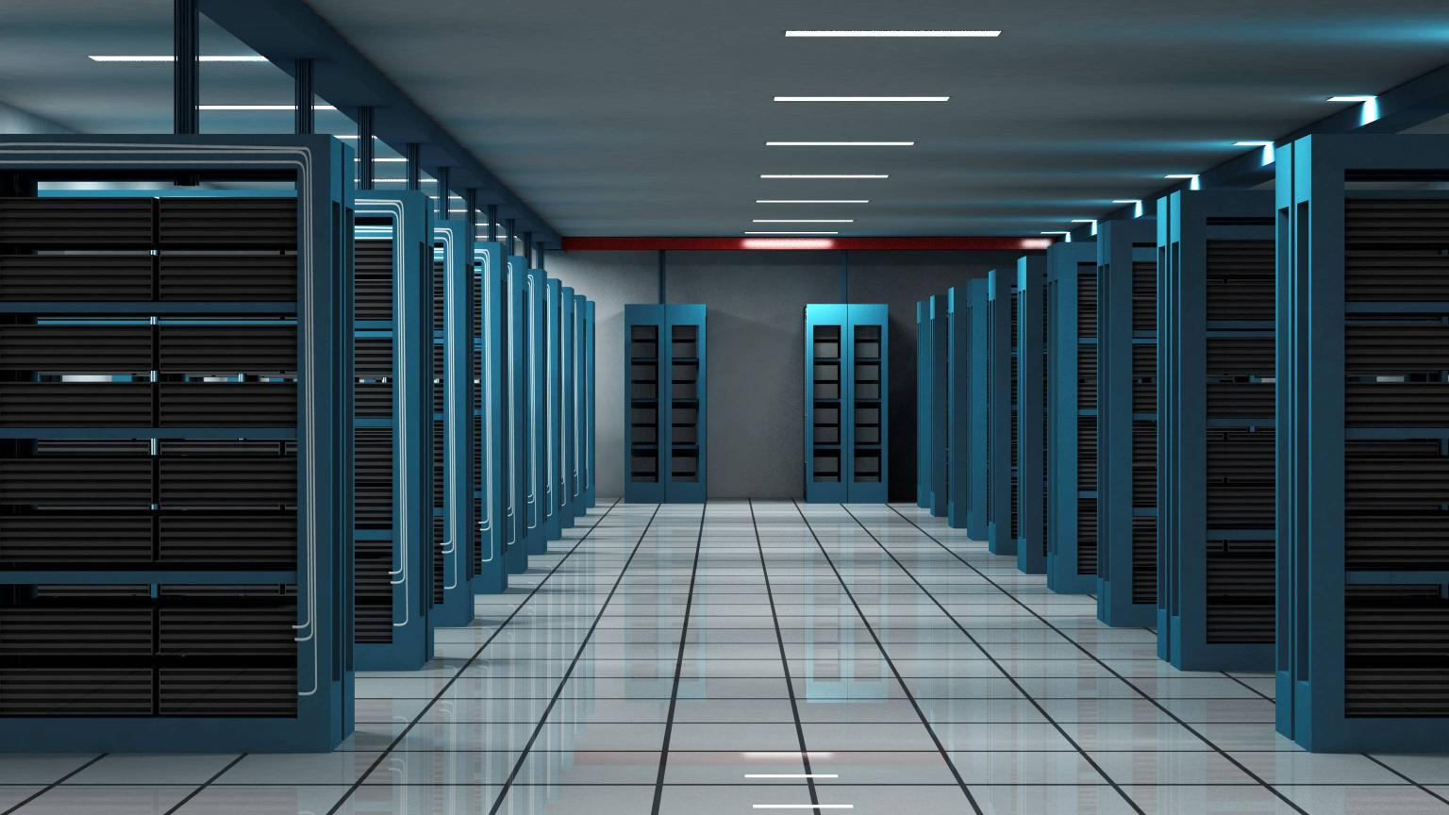
Hyper-V Host Scale & Scale-Up Workload Support
System | Resource | Windows Server 2008 R2 Hyper-V | Windows Server 2012 RC Hyper-V | Improvement Factor
Host | Logical Processors | 64 | 320 | 5×
 | Physical Memory | 1TB | 4TB | 4×
 | Virtual CPUs per Host | 512 | 2,048 | 4×
VM | Virtual CPUs per VM | 4 | 64 | 16×
 | Memory per VM | 64GB | 1TB | 16×
 | Active VMs per Host | 384 | 1,024 | 2.7×
 | Guest NUMA | No | Yes | -
Cluster | Maximum Nodes | 16 | 64 | 4×
 | Maximum VMs | 1,000 | 4,000 | 4×

Slide 30
與雲端服務無縫銜接
Common identity, management and networking technologies for secure and reliable cross-premises connectivity
公有雲\私有雲單一帳號登入整合技術
提供Hyper-V Replica 機制
Online backup (Windows Azure)
超越虛擬化
Notes:
Connect to cloud services
Windows Server 2012 RC provides a more secure and reliable platform for connecting to cloud services by using a common identity and management framework for cross-premises connectivity, federating identities, and increasing data protection.
Key features include the following:
Hyper-V Replica. Virtualization opens new, effective possibilities to ensure services are always available. Windows Server 2012 RC introduces Hyper-V Replica, a built-in feature that provides asynchronous replication of virtual machines for the purposes of business continuity and disaster recovery. Hyper-V Replica provides a storage- and workload-agnostic solution that replicates efficiently, periodically, and asynchronously over IP-based networks, typically to a remote site. It also allows an administrator to easily test the replica virtual machine without disrupting the ongoing replication. If a disaster occurs at the primary site, administrators can quickly restore their business operations by bringing up the replicated virtual machine at the replica site. Hyper-V Replica provides a virtual machine-level, affordable, reliable, and manageable replication solution that’s tightly integrated with Hyper-V Manager and Failover Cluster Manager in Windows Server 2012 RC.
Cross-premises connectivity. Windows Server 2012 RC provides the most highly cloud-optimized operating system available today. VPN site-to-site functionality in remote access provides cross-premises connectivity between enterprises and hosting service providers. Cross-premises connectivity enables enterprises to connect to private subnets in a hosted cloud network. It also enables connectivity between geographically separate enterprise locations. With cross-premises connectivity, enterprises can use their existing networking equipment to connect to hosting providers using the industry-standard IKEv2-IPsec protocol.
Online backup. Online backup reduces costs associated with backup storage and management; it can take advantage of Windows Azure cloud services and also offers options for third-party cloud services. Online backup is ideal for business continuity needs in small businesses, branch offices, and departmental deployments.
Identity federation with Active Directory Federation Services. This features allows for a common identity framework across premises and the cloud. It includes the extension of Active Directory identities to gain access to cloud resources, single sign-on (SSO) for resources on-premises and in the cloud, and support for open standards.

Slide 31
Hyper-V Replica Complements Array Based Replication
 | 複寫機制提供 | 成本 | 管理 | 效能
Hyper-V Replica | Microsoft | 富彈性的儲存設備，可有效控制建置成本 無限制的VM 複寫機制 | 以VM為單位進行複寫 高整合度的開放API , 可以與其他Vendor界接 | RPO: 5分鐘 應用程式等級資料連續性 檔案層級資料連續性
Storage Based Replication | NetApp, HP, Fujitsu, IBM, Hitachi, FalconStor, 3Par, EMC, LSI, Compellent, EqualLogic and more… | 高端儲存府寫機制 外掛資料遠端複寫軟體 | 以LUN為主發點 Layout 需與儲存管理團隊協同合作 | 同步複寫機制Synchronous Replication 海量資料流

Slide 32



Cloud drivers
靈活
聚焦
價值
Notes:
The biggest benefits of cloud computing are seen in three key areas:
Agility. Every business wants the ability to respond quickly to changes in the market or the way the business is run.
Focus. More people are able to focus on higher levels of the stack—such as managing application SLAs and rolling out new applications—without having to worry about the underlying infrastructure.
Economics. Virtualization has been a driver of efficiency in IT for nearly a decade. Cloud computing takes you further by allowing you to run multiple workloads on the same overall infrastructure, to use those resources more effectively. It also gives you elasticity, which helps you more efficiently provision resources based on demand. Both of these attributes ultimately reduce overall cost.
By moving to a cloud-based model, you can focus on the things that most improve your business, increase your organizational agility to respond to market changes, and drive down costs across your infrastructure.

Slide 33
Windows Server 2012 RC
高效率的動態私有雲平台
以符合目前商業需求並兼顧未來發展為設計理念
不浪費既有IT投資並持續提供最佳化解決方案
Notes:
Why choose Windows Server 2012 RC?
Windows Server 2012 RC is a dynamic and efficient platform for private cloud computing. It delivers a dynamic, available, and cost-effective server platform that satisfies business and IT professionals by offering:
A consistent, integrated approach that helps them solve fundamental business and IT challenges
A concrete platform that lets them take advantage of new applications and services that can be deployed on-premises and in private and public cloud environments
Windows Server 2012 RC supports yesterday’s technologies and today’s business needs while preparing you for tomorrow’s innovations. Many of the new and improved features in Windows Server 2012 RC can help you meet demanding business requirements. If you’re working with virtualized environments, many of the improvements in Hyper-V and storage technologies will help you enhance your virtual environment and reduce storage costs. For example, Windows Server 2012 RC offers high-performance file-share storage that is continually available for server applications. Implementing this feature lets you store application data on inexpensive, easy-to-manage file shares and obtain nearly the same benefits you would expect from a storage area network (SAN).
We built Windows Server 2012 RC so you can capitalize on your existing investments. By choosing Windows Server 2012 RC now, you are preparing for the future. As you continue to grow and work within a heterogeneous environment, you can select the path that is best for your business. Whether implementing a private cloud is around the corner or over the horizon for you, Windows Server 2012 RC offers the best platform to prepare for and implement cloud-optimized IT now.

