Slide 1
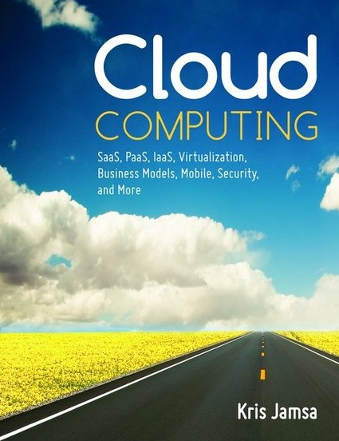

Cloud Computing
Chapter 20
The Future of the Cloud

Slide 2
Learning Objectives
Describe how the cloud will influence future operating systems.
Describe how the cloud enables location-aware applications.
Describe how the cloud will change the way people watch TV.
Describe how the cloud may enable the use of intelligent fabrics.
Describe how the cloud will enable communication among smart devices.
Describe how the cloud will drive mobile solutions and mobile solutions will drive the cloud.
Discuss the role of HTML5 in enabling new mobile applications.
Describe the role of home-based clouds.

Slide 3
Cloud’s Impact on Microsoft
Microsoft is heavily invested in all aspects of computing, including the cloud.
Microsoft’s CEO, Steve Ballmer, has publicly stated that Microsoft, like other companies, is “betting the company on the cloud.”
Windows Azure
Windows Office 360

Slide 4
Cloud’s Impact on Operating Systems
Role of virtualization
Servers
Desktops on demand
Role of thin clients and SaaS solutions

Slide 5
Location-Aware Applications
A location-aware application utilizes data from the GPS (global positioning system) capabilities built into mobile devices to integrate an individual’s location into the processing it performs.
As GPS capabilities are built into more devices, applications will begin to deliver more location-aware solutions.

Slide 6
Real World: Coupius Mobile Coupons
Users of computers and handheld devices are becoming on-demand consumers: They want what they want, when and where they want it.
Coupious Mobile Coupons provides insights into the future of coupon clipping. The site currently delivers on-demand, location-aware coupons to states along the east coast of the United States.

Slide 7
Intelligent Fabrics
Automatically adjust room temperature when body temperature becomes too warm or too cold.
Notify rooms when we enter or leave so that lights, music, and other devices are controlled.
Monitor body functions such as blood pressure, blood sugar levels, stress, and more, and notify the person and adjust the environment to affect those functions.
Notify others when an elderly person has fallen.
Provide deterrence against mosquitoes and insects.

Slide 8
The Future of Cloud TV
Companies such as Hulu are changing the way consumers watch TV.
With greater bandwidth available everywhere, DVDs will soon fall by the wayside.
Not only will TV viewers watch shows on demand in their homes, in their cars, and on airplanes, but also a new breed of projection devices will make any flat surface a TV screen.
Furthermore, users will be able to interact with content, perhaps changing the outcome of a story.

Slide 9
Cloud-Based Smart Devices
For years, futurists have forecast the day when a refrigerator would automatically create your grocery list and send the list to the store so your essentials could be delivered.
The cloud’s ability to provide Internet access any place and any time makes such processing a reality.
Some devices may initially be “intelligent” with respect to their ability to control power consumption, possibly avoiding power use during peak times and costs.

Slide 10
How HTML5 Will Drive Mobile Applications
HTML5 is the 20th anniversary update release of HTML, which supports capabilities previously available only through Flash-based development.
Using HTML5, developers can create multimedia content suitable for all devices.
As a result, HTML5 will further drive the success of mobile applications.

Slide 11
Faster Time to Market for Software Applications
The cloud streamlines many expensive and time-consuming development steps.
Companies no longer have to raise the capital required to fund a large data center. Instead, they can leverage a PaaS solution.
Furthermore, companies no longer have to pay expensive up-front licensing fees for various software tools such as database management systems. Instead, they can leverage pay-on-demand solutions.

Slide 12
Faster Time to Market Continued
Finally, companies no longer have to guess their site’s adoption rate so that they can provide the underlying computing resources. Instead, they can let their cloud-based applications scale to meet demand.
The net result: Developers will release software solutions at a faster pace, bringing the solutions to a market that expects high functionality and demands lower cost.

Slide 13
Home-Based Cloud Computing
Today, most households have wireless network capabilities that allow family members to connect to the Web and access sites and content they desire.
With the advent of smart devices, intelligent fabrics, and greater use of radio frequency identification (RFID) devices, family members will expect on-demand personalized technology solutions.

Slide 14
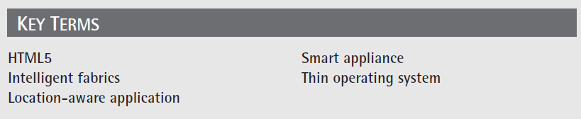
Key Terms

Slide 15
Chapter Review
List and describe five ways you think the cloud will change the future of TV.
List and describe five potential uses for intelligent fabric.
List and describe five ways the cloud will influence the mobile application market, or vice versa.
Discuss the importance of HTML 5.

Slide 16
Chapter Review Continued
Discuss how the cloud will impact future operating systems.
List and describe three potential location-aware applications.
List and describe five ways intelligent devices may work together.

