Slide 1


Cloud Computing
Chapter 18
Coding Cloud-Based
Applications

Slide 2
Learning Objectives
Use Yahoo! Pipes to create a mashup.
Create and deploy a cloud-based application using Google App Engine.
Create and deploy a cloud-based application using Windows Azure.

Slide 3
Developer Role
Developers who create new cloud-based applications or who move existing applications to the cloud are truly driving the cloud’s explosive growth.
Creating a cloud-based application is very similar to building a traditional web-based application.
Developers normally use a programing language such as PHP, Ruby, Perl, Pty, or C#, along with HTML and CSS, and a database.

Slide 4
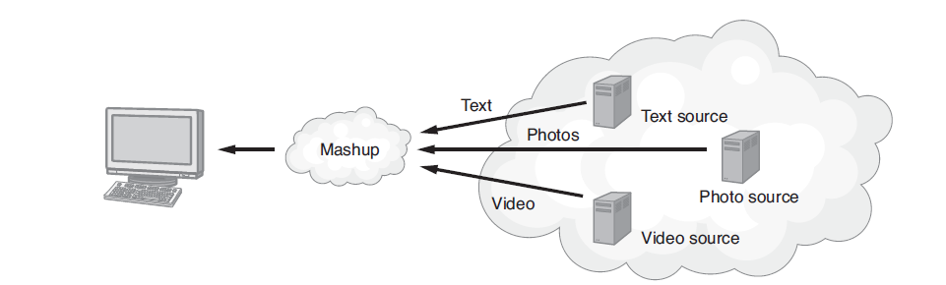
Mashup
A mashup combines content from several sources onto the same page.

Slide 5
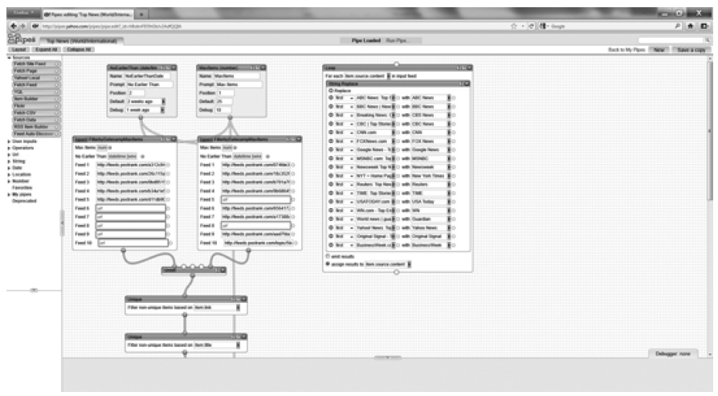
Yahoo! Pipes
Yahoo! Pipes is a cloud-based application that provides a GUI that programmers can use to combine content (create a mashup) by dragging and dropping content sources onto a canvas.

Slide 6
Creating a Simple Yahoo! Pipe
To create your own Yahoo! Pipe, visit pipes.yahoo.com
Within the page, log in to Yahoo! and click the Create Pipe button.
Your browser, in turn, will display the pipe canvas and the data sources that you can use to create your pipe,

Slide 7
Using Google App Engine
Using Google App Engine, developers can deploy applications that run on the Google infrastructure.
Google maintains the servers, scales the applications, and performs the server administration.
Developers can get started with Google App Engine at no charge. As an application’s demand increases, developers pay only for resources they consume.
Developers normally build Google App Engine solutions using Java, Python, or PHP.

Slide 8
Windows Azure
For .Net developers, creating a Windows Azure application is a natural extension of their previous ASP.NET development.
The developers will use the Visual Studio to create and deploy their applications. Eventually, support for Windows Azure will be integrated into Visual Studio.
At the time of this writing, however, developers must download and install a Windows Azure software development kit as well as tools for Visual Studio.

Slide 9
Windows Azure Continued
In addition, developers must register at the Windows Azure site—which they can do free of charge.
At the Windows Azure site, developers will find tutorials to guide them through the process of creating and deploying a cloud-based application.

Slide 10
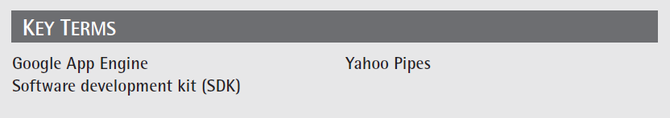
Key Terms

Slide 11
Chapter Review
Using Yahoo! Pipes, create a pipe that displays the names of pizza restaurants within a given zip code.
Using Google App Engine, create a page that displays the following Python script:
print "Content-type: text/html\n\n"
print "<html>Cloud Computing, Chapter 18</html>"

