Slide 1
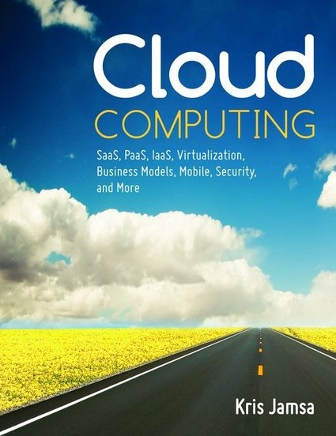
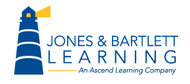
Cloud Computing
Chapter 17
Designing Cloud-Based
Solutions

Slide 2
Learning Objectives
Compare and contrast functional and nonfunctional system requirements.
Understand why developers should delay selecting an implementation platform during the design phase.
Discuss considerations designers should evaluate when they design a system to meet specific nonfunctional requirements.

Slide 3
Revisit the System Requirements
Before you begin the design process, ensure that you have a complete set of system requirements.
If the requirements were defined by another individual or group, review the requirements and then walk through your understanding of them with the group and ideally the stakeholder who served as the expert for the requirements specification.
Identifying errors, omissions, and misunderstandings early in the design process will save considerable time and money later.

Slide 4
Two Categories of Requirements
The functional requirements specify what the system does—that is, the specific tasks the system will perform.
Normally, the functional requirements are provided by the system or business analyst to the designer within the specification of the things that the system needs to do.
Nonfunctional requirements specify how the system will work behind the scenes. Often called quality requirements and include performance, reliability, maintainability, and so forth.

Slide 5
Delay Selecting a Development Environment
When designing solutions, you should hold off on the implementation details as long as you can.
Your design goal is to understand the requirements (functional and nonfunctional) fully and then to evaluate alternative solutions and implementations.
If you focus too soon on platform capabilities, the platform may begin to dictate your design, not only for a specific requirement, but also for the requirements that follow.

Slide 6
Design Is a Give-and-Take Process
Designing a system is challenging.
Budgets and time constraints mean you cannot solve every problem.
You need to consider the common design issues and help the stakeholders prioritize the solutions.
Remember the 80/20 rule (Often 80% of a program’s processing takes place within 20% of the code). You will want to focus your system design on the issues that will produce the greatest impact for the stakeholders.

Slide 7
Designing for Accessibility
For a public solution, such as a consumer website, maximizing user access not only makes great marketing sense, but also may be required by law (see the Americans with Disabilities Act website at www.ada.gov).

Slide 8
Real World: VoicePay Cloud-Based User Authentication
Authenticating a mobile device user can be challenging.
Often, mobile users will preconfigure different pages to “remember” them in order to simplify login processes. If a user loses the device, another person may be able to access those pages.

Slide 9
VoicePay Continued
VoicePay has an interesting voice-based biometric authentication capability.
When a user wants to make a purchase or log in to a specific site, the user calls VoicePay and speaks.
The system, in turn, uses the user’s voice profile to authenticate him or her.
The user does not have to provide a username, password, or other confidential information—all he or she has to do is speak.
As mobile device use continues to grow exponentially, biometric solutions such as those offered by VoicePay will become mainstream.

Slide 10
Real World: Web Accessibility Initiative
Designing for user access is not just good business—for most web-based companies, it is a matter of law.
To help designers understand potential solutions and user needs, the World Wide Web Consortium (W3C) has developed guidelines within its Web Accessibility Initiative pages.
Before you begin a user interface design, you should review these accessibility issues and requirements.

Slide 11
Designing for Audit
As you design a cloud-based solution, you must first identify critical processing points at which you will want to place an internal control to confirm that the solution’s processing is correct and free from outside manipulation.
You may design such controls to be active, meaning the code may generate a processing exception should unexpected results occur; or, the control may be passive, possibly logging events to a file or saving snapshots of data.

Slide 12
Designing for Availability
Most cloud-solution providers, within their SLA, will guarantee the system availability, normally with a percentage of uptime, such as 99.9 percent.
For most applications, 99.9 percent uptime is acceptable (99.9 percent uptime means that the system is down 0.1 percent of the time, or 525 minutes each year).
It is important that you identify your system’s uptime requirement and then, likely through the use of redundant collocated servers, design a solution that meets your needs.

Slide 13
Designing for Backup
If you are designing your own solution, you must consider not only ways to back up your data (and databases), but also the impact of each method on your system availability, should you need to bring down the system to restore a backup.
Designing redundant data-storage solutions will always involve a cost versus risk trade-off. The issue is not whether you back up data—data backups should be a given, always. The issue is aligning acceptable risk mitigation with cost.

Slide 14
Designing for Existing and Future Capacity
If you are moving an existing on-site solution to the cloud, you should monitor the application closely to fully understand its processing attributes, such as user demand, CPU utilization, RAM use, and data-storage consumption.
Knowing your system’s current resource use, you can better guess (it is difficult to predict system demand accurately), your system’s cloud resource needs.

Slide 15
Designing for Scalability
First, you can scale the application up (called vertical scaling) by moving the application to a faster, more powerful processor.
Second, you can scale an application out (called horizontal scaling) by distributing different tasks across different servers.

Slide 16
Designing for Configuration Management
Ideally, cloud-based solutions may be used at any time, from any place, with any device.
Developers must consider a variety of operating systems, browsers, and device-specific GUIs. Operating systems and browsers often require patches to address security issues, and, eventually, each will face new version releases.
If you are designing your own solution, you will want to layer configuration solutions on top of your system.

Slide 17
Designing for Deployment
Desktop virtualization is changing how solutions are delivered. From an operating system on demand, to thin-client (browser-based) solutions, developers have a myriad of ways to deploy a system.
As you design a solution, you should identify each potential user type and its environment attributes.
Consider not only how you will deploy the initial solution, but also how you will deploy system upgrades.

Slide 18
Designing for Disaster Recovery
When designing a solution with respect to disaster recovery and business continuity, you must balance risks and costs.
It is likely impossible and unnecessary to protect a system from all potential events.
Instead, you must determine each event’s likelihood and business impact and then seek to provide an affordable solution that mitigates risks.
Fortunately, the cloud’s affordable and distributable resources provide developers with considerable flexibility.

Slide 19
Designing for the Environment (Green Computing)
Green computing describes environmentally friendly IT operations.
For example, replacing an application that prints reams of paper reports with a browser-based performance dashboard is an example of a green-computing initiative.
As green-computing practices continue to emerge, designers will be pressured to consider the environmental impact of their designs.

Slide 20
Designing for Interoperability
To simplify the user interaction between cloud-based solutions, many companies strive to integrate the solutions and often, even to share data across solutions.
In the past, companies would buy and install middleware software to facilitate the exchange of data between solutions.
Today, there are cloud-based middleware solutions that let companies tie together two cloud-based solutions, often without the need for programming development.

Slide 21
Designing for Maintainability
Designing and building software solutions is an expensive process.
Usually, the most costly phase of the software development life cycle is the maintenance phase.
By decomposing an application into highly cohesive, loosely coupled modules and then deploying those solutions to applications such as web services, developers not only increase component reuse, but also make the resulting systems easier to maintain.

Slide 22
Designing for Performance and Scalability
Designing for performance and designing for scalability are two different issues.
Designing for performance means optimizing what you have.
Designing for scalability means designing for the future integration of additional computing resources.

Slide 23
Designing for Performance
Reduce the use of graphics on key pages.
Optimize the graphics file format for all images.
Compress large text blocks before downloading the text to a browser.
Utilize data and application caching.
Fine-tune disk and database I/O operations.
Reduce, when possible, network operations.
Fine-tune secure data communication transactions.

Slide 24
Designing for Price
Budgets are a fact of life.
As you design, you must be aware that your design decisions have financial implications.
A solution that was inexpensive to deploy may prove costly to maintain, or vice versa.
You must consider the short-term and long-term budget impacts of each system component.

Slide 25
Designing for Privacy
Cloud-based solutions must protect a user’s data privacy.
If you are developing a healthcare solution with HIPAA requirements, an education solution with FERPA requirements, or an e-commerce solution that stores credit card information, you will need to design your solution in a way that protects data not only from external access, but also from internal users, such as developers and administrators.

Slide 26
Designing for Portability
Portability is a measure of the ease of which a solution can be moved, typically, from one platform to another.
If you are designing your own solutions, be aware that using a provider-specific application program interface (API), which may not be available through other providers, may create a form of vendor lock-in.

Slide 27
Designing for Recovery
You should design your solution with consideration for how you will recover from more common events, such as server failure, user error, power outages, and so on.
Your recovery design should tie closely to your backup design and your system redundancy design.

Slide 28
Designing for Reliability
Computing devices (disks, servers, routers, and so on) will eventually fail.
As you design your solutions, you must identify potential signal points of failure and then design potential system redundancy or establish an acceptable system downtime.

Slide 29
Designing for Response Time
You should keep the user experience in mind. As discussed, users are conditioned to expect fast system response.
A large percentage of users will leave a site if they have to wait more than a few seconds for pages to download and display.
As you design a solution, you need to consider not only the page download times, but also the system response time after a user performs an operation, such as submitting a form.

Slide 30
Designing for Robustness
Robustness is a measure of a site’s ability to continue operations in the event of an error or system failure, such as a server failure or database error.
As you design, you should strive to identify and eliminate single points of failure.
Furthermore, you should consider automating a system resource utilization monitor that alerts administrators before a system’s resources become critically low.

Slide 31
Designing for Security
Software patch installations and software version management
HR vetting of cloud-based personnel
Early awareness of security incidents and appropriate responses
Data privacy issues and considerations
Jurisdictional issues for a remote cloud-service provider

Slide 32
Designing for Security Continued
Multitenant solution issues
Cloud-provider failure or collapse
Defense mechanisms for common low-level network attacks
Data wiping for shared-storage space
Physical security considerations

Slide 33
Designing for Testability
Cloud-based solutions may have a large number of functional and nonfunctional requirements.
As you design a solution, keep in mind how you will test various aspects of your design.
The system’s nonfunctional requirements are often the most difficult to test.
Depending on a component’s purpose and functionality, developers may use a methodology called test-driven design by which they first design and implement one or more test cases, and then, build a solution that can satisfy the test.

Slide 34
Designing for Usability
Usability, in the world of IT, is understood as a measure of a system’s ease of use.
As you design a solution, you must keep the user foremost in your mind.
Because of the importance of meeting system usability requirements, many designers will model or create a prototype of the user experience so they can receive user feedback early in the design process.

Slide 35
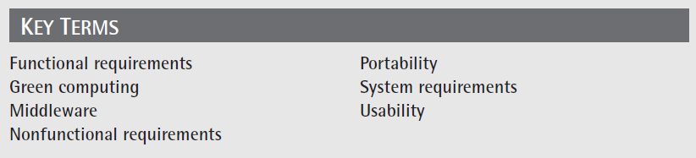
Key Terms

Slide 36
Chapter Review
Compare and contrast functional and nonfunctional requirements and provide an example of each.
Discuss why a designer should avoid selecting an implementation platform for as long as possible during the design process.
Discuss various trade-offs a designer may need to make with respect to nonfunctional requirements.
Discuss why the system maintenance phase is often the most expensive phase of the software development life cycle.

