Slide 1
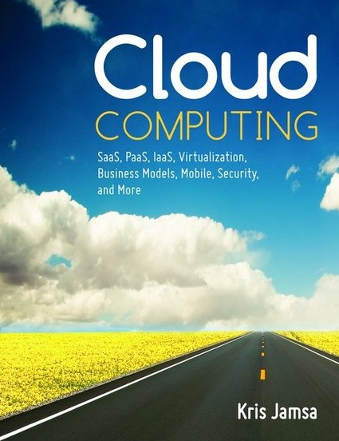

Cloud Computing
Chapter 16
Evaluating the Cloud’s Business Impact and Economics

Slide 2
Learning Objectives
Discuss the total cost of ownership for an IT solution.
Compare and contrast the capital expenses and operational expenses of an IT solution.
Describe supply-side savings made available through large-scale, cloudbased data centers.
Describe and discuss the efficiencies gained to providers through multitenant applications.
Describe and discuss the “right sizing” process.
Identify the primary costs of a data center.
Describe how Moore’s law relates to the cloud.

Slide 3
Cloud’s Business Impact
The cloud is bringing with it new business models and economics.
Large companies are saving costs, reducing staff, and improving system scalability by moving from on-site data centers to the cloud.
Small companies are leveraging pay-on-demand models to “right size” their computing needs quickly and cost effectively.

Slide 4
Total Cost of Ownership
The total direct and indirect costs, including capital and operating expenses, of owning a particular piece of equipment or other capital good.
When you examine the economics of the cloud, you need to consider the total cost of ownership of an on-site solution compared with that of the cloud.

Slide 5
Cost Components of Software
Software (server, desktop, notebook, tablet, and mobile)
Prepurchase research
The actual software purchase or licensing
Installation
Training
Version and patch management
License management
Security considerations
Administration

Slide 6
Cost Components of Hardware
Hardware (server, desktop, notebook, tablet, and mobile)
Prepurchase research
The actual hardware purchase
Installation
Testing
Footprint and space
System downtime
Electricity and air conditioning

Slide 7
Cost Components of Hardware Continued
Insurance
Replacement costs of failed components
Decommission, removal, and disposal of previous equipment
Cost of scaling solutions to new demands
Footprint and space
System maintenance

Slide 8
Cost Components Data Storage
Prepurchase research
The actual device purchase
Installation and Testing
Security considerations
Backup operations
Footprint and space
Electricity and air conditioning
Maintenance
Replacement costs of failed components

Slide 9
Cost Components Networks
Internet access (Internet service provider)
Prepurchase research
The actual component acquisition
Installation
Training
Security considerations
System downtime
Maintenance
Administration

Slide 10
Real World: Amazon Total Cost of Ownership Spreadsheet
To help users calculate and then compare the total cost of ownership for a cloud-based solution, collocated solution, and on-site solution, Amazon provides an Excel spreadsheet.
Using this spreadsheet, you can perform a detailed analysis of the costs related to each solution.

Slide 11
Economies of Scale
Describes the cost savings that a company may experience (up to a point) by expanding.
Assume, for example, that a data center has two system administrators who oversee 100 servers. Each administrator is paid $50,000. The cost per server for system administration becomes:
Administrative costs: = $50,000 + 50,000
= $100,000
Administrative cost per server = $100,000 / 100
= $1000

Slide 12
Economies of Scale Continued
Assuming the servers are running similar operating systems, the two administrators may be able to oversee as many as 1000 servers. In that case, the cost per server for system administration becomes the following:
Administration cost per server = $100,000 / 1000
= $100

Slide 13
Capital Expenditures (CAPEX)
Large expenditures, normally for a plant, property, or large equipment. Companies make large capital expenditures to meet current or future growth demands.
Because capital expenditures have value over a number of years, companies cannot expense the expenditures in full during the current year.
Instead, using a process called expense capitalization, the company can deduct a portion of the expense over a specific number of years.

Slide 14
Operational Expenses (OPEX)
Expenses that correspond to a company’s cost of operations. Within a data center, for example, operating expenses include the following:
Power and air conditioning
Rent and facilities
Equipment maintenance and repair
Internet accessibility
Software maintenance and administration
Insurance

Slide 15
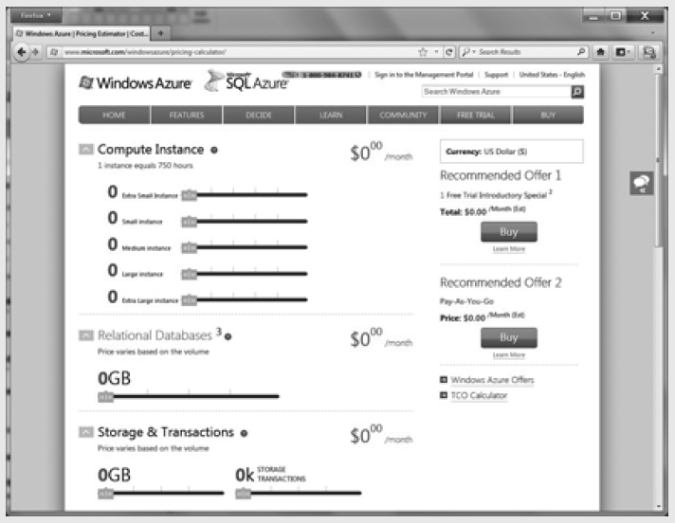
Real World: Microsoft Operational Expense Calculator
To help companies compare their operational costs to those of the Windows Azure platform as a service, Microsoft provides the Windows Azure pricing calculator.

Slide 16
Return on Investment (ROI)
A measure of the financial gain (or return) on an investment, such as a new piece of equipment.
For example, assume that a company can repeatedly save $10,000 based on a $50,000 investment. The company’s first-year ROI would become:
Return on investment (ROI) = Income (or savings) / Cost
= 10,000 / 50,000
= 0.20 or 20 percent

Slide 17
Benefits of Monthly Cloud Use
Rapid scalability
Reduced total cost of ownership
Improved business continuity and disaster recovery
Increased cost controls
Enhanced ability to “right size”

Slide 18
Profit Margin
Often simply called the margin, it is a ratio of the company’s income to revenue:
Profit Margin = (Income / Revenue) * 100
Assume, for example, a company has $500,000 of revenue and the following expenses:
Non-IT related expenses: $300,000
IT data center expenses: $150,000
----------
Total expenses: $450,000

Slide 19
Profit Margin Continued
To calculate the company’s income or profit, you simply subtract the expenses from the revenues:
Profit = Revenues – Expenses
= $500,000 – $450,000
= $50,000

Slide 20
Profit Margin Continued
Then, you can calculate the company’s profit margin as follows:
Profit margin = (Income / Revenue) * 100
= (50,000 / 500,000) * 100
= 10 percent

Slide 21
Moore’s Law
Gordon Moore, one of the cofounders of Intel, identified a computing trend during the 1960s that remains true today:
The number of transistors that can be placed on an integrated circuit doubles every two years.

Slide 22
Moore’s Law and the Cloud
We find that computing power and disk storage capacity also double at nearly this rate.
The result is that a capital investment in computing devices has a very short effective life expectancy.
The systems we buy today may be only half as fast as those we will purchase two to three years from now.
By shifting computer resources to the cloud, companies eliminate the need to update their own data center equipment, which may drive a considerable cost savings.

Slide 23
Other Performance Measures
System availability
Processor utilization
Time-of-day utilization
Resource demand/utilization
Time to market
Opportunity costs
User experience
Market disruption

Slide 24
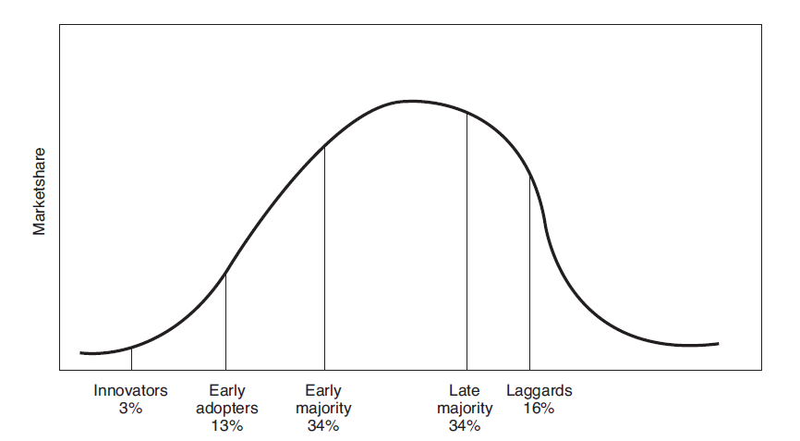
Cloud Market Adoption
The cloud’s market adoption cycle is similar to that of most new product and service offerings.

Slide 25
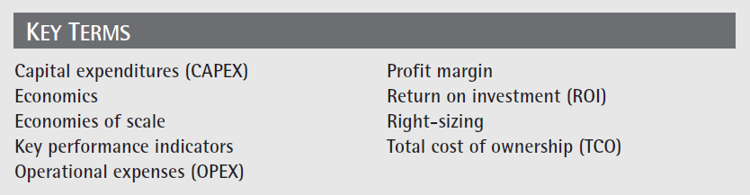
Key Terms

Slide 26
Chapter Review
Define and describe total cost of ownership. List at least 10 items to consider when determining a data center’s total cost of ownership.
Define and describe a capital expense. How are capital expenses different from operational expenses?
Define and describe economies of scale and provide a cloud-based example.
Define and describe “right sizing” as it pertains to cloud computing.

Slide 27
Chapter Review Continued
Define Moore’s law and discus how it might influence cloud migration.
Given company revenues of $2.5 million and expenses of $2.1 million, calculate the company’s profit and profit margin.

