Slide 1


Cloud Computing
Chapter 14
Mobile Cloud Computing

Slide 2
Learning Objectives
Describe the evolution of mobile computing
Discuss the different generations of cell phones
Discuss the ecosystem that comprises the mobile web
Describe the roles of phone network operators, transcoders, and proxies
Compare and contrast web pages, applications (apps), and widgets
Discuss the importance of HTML5 with respect to mobile development
Describe mobile development considerations

Slide 3
Which Came First?
Is the cloud is driving the growth of mobile computing or mobile computing is driving the growth of the cloud?

Slide 4
Smartphone Use
Browse websites, including Google, Facebook, eBay, and more.
Place face-to-face video calls to phones and computers.
Perform GPS-based navigational operations.
Exchange text messages.
Perform e-commerce operations.
Run a myriad of applications (apps).

Slide 5
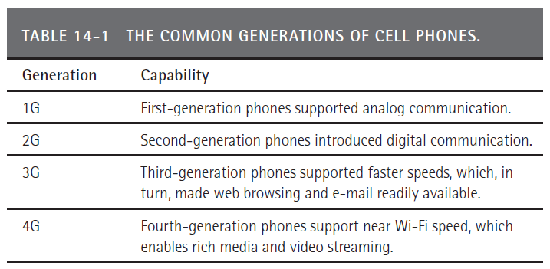
Understanding the G in 3G and 4G
When you discuss phone capabilities, you will hear terms such as 3G and 4G. In the simplest sense, the G stands for generation.

Slide 6
Mobile Cloud Ecosystem
An ecosystem is an environment that consists of living and nonliving things with which one interacts.
Many cloud-based companies use the term ecosystem to describe the user’s environment.

Slide 7
Mobile Cloud Ecosystem Continued
Items in the Mobile Cloud Ecosystem include:
Phone class, which may be voice or face-to-face
Web browsing
Applications (apps) and widgets
Voice commands and voice recognition
Display screens
Transmission speeds for upload and download operations
Keyboard interface
Touchscreens

Slide 8
Mobile Cloud
The mobile cloud consists of apps and web pages that originate from sites within the cloud from which users download, or with which they interact via a mobile device.
When you create a mobile solution, you should consider how your solution interacts with or supports the various mobile-device ecosystem components.

Slide 9
Mobile Transcoder
Within a mobile network, a transcoder may modify web content to a form and layout more suitable for a mobile device.

Slide 10
Pages, Apps, and Widgets
Developers build mobile solutions in one of three ways:
First, they can build a web page, ideally targeted for a mobile display. As users browse the Web using mobile browsers built into their phones, the contents of the web page appear.
Second, developers can build an app, which typically is a device-specific program that users download and install (either free or for a price) onto a device.
Third, developers can create a widget, which is much like an app that the user downloads and installs to his or her mobile device. A widget differs from an app in that the widget is always active.

Slide 11
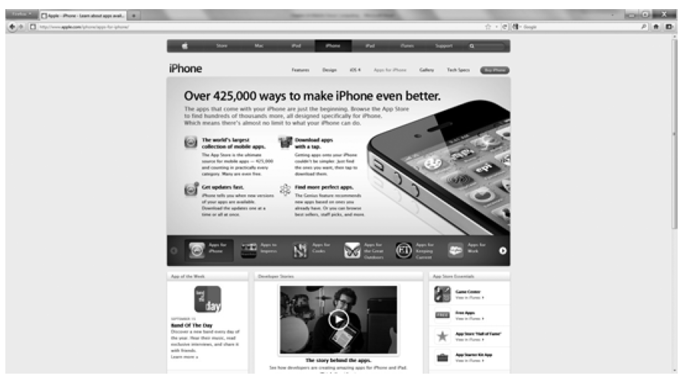
Endless Apps
From business apps, to games, to education, there are hundreds of thousands of apps available for the iPhone.

Slide 12
Real World: W3C Mobile Page Checker
Web developers should be familiar with the W3C website and its outstanding development tutorials and tools.
When it comes to malformed HTML tags, mobile web browsers, because of their compact size (code size), tend not to be as forgiving as desktop browsers.
Before you launch your mobile pages, you should validate your code using the S3C Mobile Checker at www.w3c.org/mobile

Slide 13
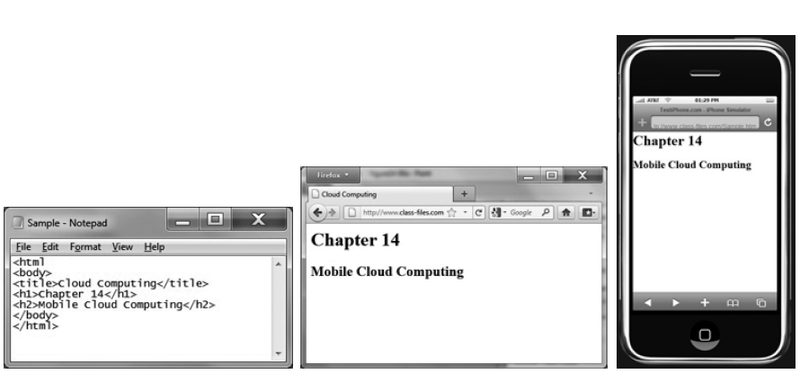
HTML Markup
An HTML markup file and its display within a web browser and mobile device.

Slide 14
Revisiting the Role of HTML5
HTML5 is the fifth major release of HTML.
HTML5 is important because developers can use it to create multimedia pages similar to what they previously created using Flash.
Unlike Flash-based pages, which handheld browsers could not display, HTML5 multimedia pages display on all devices. In this way, HTML 5 opens a vast new area of development for mobile devices.

Slide 15
Mobile Device Requirements
The mobile web is not the traditional web
Fast is good
Remember your goals and requirements
You cannot support everything
Do not treat mobile content as an afterthought; create, do not convert, mobile content
Handle different display sizes differently

Slide 16
Real World: WebKit Browser
As you drill down through the specifics of mobile web browsers, you will find that many run the WebKit open source browser.
You can learn more about this browser and download the source code at the WebKit website, www.webkit.org

Slide 17
Real World: mobiReady Page Checker
Developers will often customize web pages for mobile delivery.
As you develop your pages, you should test their content against the mobiReady page checker.
As you enter a URL on the mobiReady page, the site will evaluate your page content and display a detailed report.
Based on the report feedback, you can adjust your page components.

Slide 18
Real World: The “.mobi” Top-Level Domain
Developers will often create separate web pages for mobile-device display.
To direct users to those pages, developers have several options. First, they can have their web software detect the device type, such as a computer or phone, and then download the appropriate pages dynamically.
Second, many developers will place the letter “m” before their site domain name (creating a subdomain), such as m.somesite.com or even mobile.somesite.com.

Slide 19
“.mobi” Continued
Third, just as sites use the domain types .com, .org, and .edu, many mobile-based sites now use the “.mobi” domain type, such as www.somesite.mobi.
Developers can purchase a .mobi-based domain name at most domain name registry sites.

Slide 20
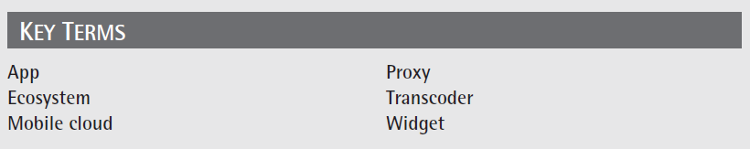
Key Terms

Slide 21
Chapter Review
Define and describe the mobile web.
Describe the different generations of cell phones.
Describe how smartphones differ from ordinary cell phones.
Select a mobile or traditional website that interests you. Describe the site in terms of the ecosystem that makes up the site’s user experience.
Describe how web pages differ from apps and how apps differ from widgets.

Slide 22
Chapter Review Continued
Discuss why developers say that HTML5 will drive mobile solutions.
Describe some development best practices for designing solutions for the mobile cloud.

