Slide 1
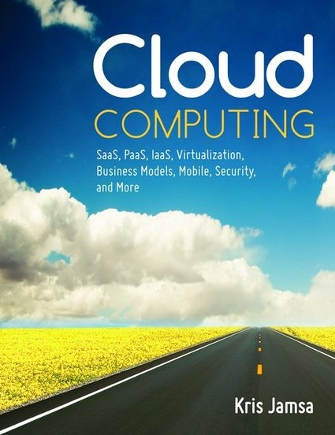

Cloud Computing
Chapter 13
Migrating to the Cloud

Slide 2
Learning Objectives
Define requirements for migrating an application to the cloud.
Describe the importance of backing up data before and after moving an application to the cloud.
Appreciate the benefit of using experienced consultants to assist with a cloud migration.
Describe an application in terms of its resource use.
Define and describe vendor lock-in and discuss ways to avoid it.
Describe the importance of training employees before, during, and after a cloud migration.
Describe the importance of establishing a realistic cloud-deployment schedule.
Discuss key budget factors impacted by the cloud.
Discuss potential IT governance issues related to the cloud.
Define and describe cloud bursting.

Slide 3
Migration to the Cloud
An application can be moved to the cloud quickly.
There are a myriad of cloud-solution providers who will eagerly assist by giving you instant access to cloud-based servers, data storage, and support.
Like all IT projects, the process of moving an application to the cloud, or the process of creating and deploying a new cloud application, should be well planned.

Slide 4
System Requirements
All IT projects should begin with specific requirements. The process of taking an application to the cloud, known as cloud migration, is no exception. The cloud-migration process should start with defined requirements.

Slide 5
Common Cloud System Requirements
Data security and privacy requirements
Site capacity plan—the resources that the application initially needs to operate
Scalability requirements—the measurable factors that should drive scaling events
System uptime requirements
Business continuity and disaster requirements
Budget requirements
Operating system and programming language requirements

Slide 6
Common Cloud System Requirements Continued
Type of cloud: public, private, or hybrid
Single- or multitenant solution requirements
Data backup requirements
Client device requirements, such as computer, tablet, or smartphone support
Training requirements
Help desk and support requirements
Governance and auditing requirements
Open source software requirements

Slide 7
Common Cloud System Requirements Continued
Programming API requirements
Dashboard and reporting requirements
Client access requirements
Data export requirements

Slide 8
Real World: CloudSwitch Cloud Migration
Many companies have enterprise-based applications that are widely used by their employees.
These applications, therefore, are mission critical.
CloudSwitch provides a downloadable application that companies can install within their data center and that securely maps the company’s on-site applications to a cloud-based solution in a matter of minutes.

Slide 9
Protect Your Existing Data
Before you begin your application migration to a cloud provider, make sure that you back up your data so that you can revert, if necessary, to a known point.
Then, be sure that you and the provider agree to the backup procedures that will be employed after they take control of your data.
It is easy to move a solution to a cloud provider. You need to ensure that it is equally easy to move out of the cloud if necessary.

Slide 10
Protect Your Data Privacy
If your company has specific privacy requirements, such as those of the Health Insurance Privacy and Portability Act (HIPAA) for health care, or of the Family Educational Rights and Privacy Act (FERPA) for education, have your provider state explicitly, in writing, its data privacy policies and procedures.

Slide 11
Use an Experienced Cloud Consultant
Moving a solution to the cloud is a learning experience.
The process has many options and a wide range of potential pitfalls.
Many companies provide consultants who are experienced in the cloud migration process.
Before you begin your application’s migration to the cloud, you should consider hiring a consultant. In most cases, you will find that hiring a consultant saves you money in the end and helps you avoid costly mistakes.

Slide 12
Know Your Application’s Current Characteristics
Before you move your application to the cloud and risk facing scaling issues, be sure that you monitor your application to identify its key performance indicators.

Slide 13
Common Characteristics
Demand periods—Does the application have periods of high or low demand, such as 8 a.m. to 5 p.m.?
Average users—How many users typically use the system simultaneously?
Disk-storage requirements—What are the application’s typical disk-storage needs? Are the files permanent or temporary? Are most operations read or write operations?

Slide 14
Common Characteristics Continued
Database-storage requirements—What are the application’s database requirements? Is the database replicated in real time? What is the application’s database read/write ratio?
RAM use—What is the application’s range of physical and virtual memory use?
Bandwidth consumption—What is the application’s bandwidth requirement?
Caching—How does the application currently cache data?

Slide 15
Remember Vendor Lock-In
Occurs when a vendor makes it difficult for a company to switch to another provider, even if the vendor has failed to fulfill the SLA.
This lock-in may occur because the vendor is unable to export data completely, or because the vendor provides services its competitors do not.
A cloud-service provider should make it easy for clients to move to another provider in the event that the provider fails to meet one or more of the SLA requirements.

Slide 16
Real World: Kayako Help Desk Solutions
Change-management consultants often cite the integration of a trained help desk staff as key to an application’s successful integration. Kayako, provides a variety of key help desk tools that a company should consider before migrating a solution to the cloud:
Support ticket management
Ticket escalation support
Live support desk chat software
VoIP phone integration
Remote computer access

Slide 17
Define Your Training Requirements
To reduce employee stress during an application’s migration to the cloud and to increase employee productivity with the cloud-based tools, you should consider training before, during, and after the cloud migration.

Slide 18
Training Requirements
Employee preparedness for the SaaS solution
Developer training on the solution APIs
Administrator training for cloud-based operations
IT-audit group training for corporate governance issues and internal controls
Help desk support preparedness training
Business continuity and disaster preparedness training

Slide 19
Real World: RightScale Cloud Application Management
RightScale provides a fully automated cloud-management platform that lets companies deploy cloud-based solutions across one or more clouds.
RightScale provides its cloud-management software as an SaaS solution that lets customers deploy and manage their solutions quickly.
The RightScale website also features valuable videos, white papers, and forums that focus on cloud computing.

Slide 20
Establish a Realistic Deployment Schedule
Cloud providers can quickly deploy solutions.
You should set a deployment schedule that provides sufficient time for training, testing, and benchmarking.
Many organizations will use a beta-like release schedule that gives employees a prerelease chance to interact with the software and provide feedback.
The testing period may provide time for the company to establish early system-performance benchmarks.

Slide 21
Budget Factors
Current data center costs breakdown, including:
Rent
Power and air conditioning
Collocation costs
Server costs
Data storage costs
Network costs

Slide 22
Budget Factors Continued
Current payroll costs for existing site administrators and projections for possible staff reduction opportunities
Current costs for software licenses that may shift to the cloud, and the (lower) projected cloud-based costs for the software
Current payroll costs for patch management and software version updates
Current hardware maintenance costs

Slide 23
Real World: GoGrid Hosting
GoGrid is a very large IaaS solution provider that provides scalable solutions to thousands of customers.
At GoGrid, customers can acquire on-demand solutions for physical, virtual, or hybrid servers at cost effective pricing levels.
Additionally, GoGrid offers solutions for load balancing, collocation, and cloud-based data storage.

Slide 24
IT Governance
Before you migrate an application to the cloud, consider the following governance requirements:
Identify how the cloud solution aligns with the company’s business strategy.
Identify and define the internal and external controls the company will need within the application, and at what control points, in order to validate that the application is performing correctly and is free from possible external modification.
Describe risks the IT staff is trying to mitigate and ways the cloud can help.

Slide 25
IT Governance Continued
Describe who within the company will have access to data within the cloud and how they will get it.
Determine who within the cloud provider’s organization will have access to data within the cloud and how they will get it.
Discover how the cloud provider logs errors and system events and how you can access them.
Determine how and when the cloud provider performs system updates and patches.
Discover which performance-monitoring tools are available for your use.

Slide 26
Cloud Bursting
When an on-site application encounters increased user demand, the application expands into the cloud.
When the user demand declines, the application leaves the cloud.
Cloud bursting is most common for seasonal demand, or event-driven demand, such as the load on Google Maps when an earthquake or other natural disaster occurs.

Slide 27
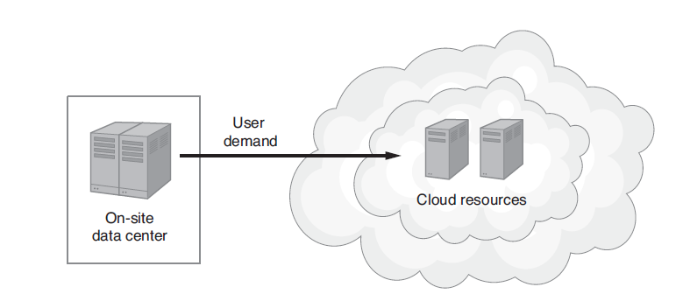
Cloud Bursting Continued
Cloud bursting lets a company extend an on-site application into the cloud to scale temporarily to meet user demand.

Slide 28
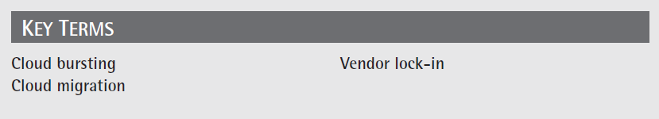
Key Terms

Slide 29
Chapter Review
List and describe common system requirements one should consider before moving an application to the cloud.
Discuss why a company should consider using a consultant to oversee a cloud migration and list specific skills you would expect the consultant to have.
List and discuss resource utilization characteristics one should monitor for an application prior to moving the application to the cloud.

Slide 30
Chapter Review Continued
List possible training requirements for an SaaS solution integration, a PaaS application migration, and an IaaS application migration.
List and describe budget considerations one should evaluate before moving an application to the cloud.
List and describe IT governance considerations one should evaluate before moving an application to the cloud.
Define and describe cloud bursting.

