Slide 1


Cloud Computing
Chapter 11
Service-Oriented Architecture

Slide 2
Learning Objectives
Define and describe SOA.
Compare and contrast the roles of web services and web pages.
List common examples of web services.
Discuss the benefits of treating a web service as a black box.
Discuss governance challenges in using web services.
Discuss the role of the Web Service Description Language (WSDL) to describe a web service and its methods.

Slide 3
Services Oriented Architecture (SOA)
Describes the major components that comprise a system, their relationships, and the information the components exchange.
The distributed nature of the cloud has provided an ideal platform to support service-oriented architecture (SOA), an architectural approach to building solutions through the integration of services.

Slide 4
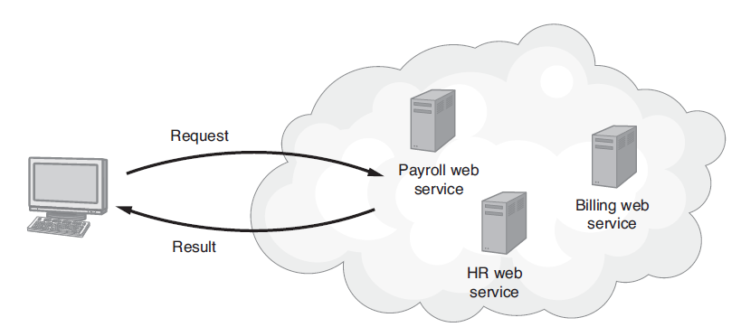
SOA and Web Services
Within SOA, programs make remote-procedure calls to services that reside on servers distributed across the Web.

Slide 5
Web Services Are Not Web Pages
A web service is program code that resides on the Web and performs a specific task that other programs, not people, use. The following are examples of tasks performed by a web service:
  Return the weather conditions for a specific zip code
  Return real-time traffic conditions for a road or highway
  Return a stock price for a particular company
  Return driving directions to a specific location
  Return the country associated with an IP address

Slide 6
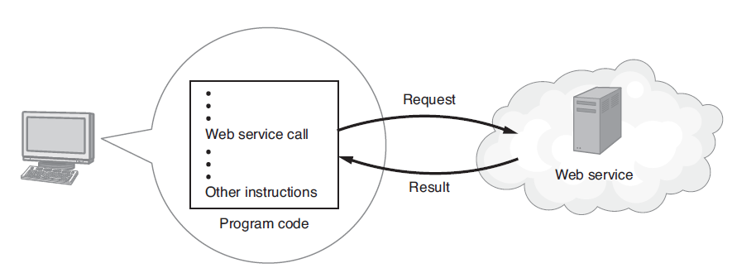
Message Passing to a Web Service
A program exchanges messages with a web service to call a specific method and then normally waits for the web service to return its result.

Slide 7
Real World: Xmethods.com
As programmers develop web services, often they will share them with others—sometimes free, sometimes not.
At the XMethods website, you can find a wide variety of web services available for use within programs.
Even if you are not a developer, you should visit the site to gain a better understanding of the types of tasks performed by web services.

Slide 8
Advantages of Web Services
Primarily because of their distributed nature, web services provide advantages to developers, the most important of which is ease of code reuse.
When programmers develop code, they break large, complex operations into smaller, more manageable tasks.
Then they implement the well-defined tasks as functions. Ideally, each function should perform one task only.

Slide 9
Advantages of Web Services Continued
Programmers can reuse the function code in other programs, which saves development and testing time and ultimately reduces costs.
A common rule of programming is not to “reinvent the wheel,” which means that if another programmer has written code that performs the task that your program needs, you should reuse that code.
Web services are ideal for code reuse.

Slide 10
Disadvantage of Web Services
Because web services require network operations, a web service will be considerable slower than a program’s call to a function that resides on the same computer.

Slide 11
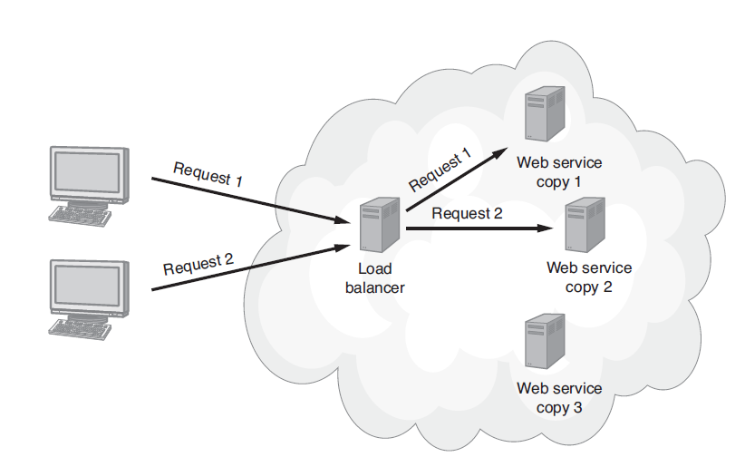
Scaling a Web Service
Using a load-balancing model, developers can scale a web service solution.

Slide 12
Coupling
Describes the degree of dependence between a calling program and the web service.
Ideally, to use a web service, a program only needs to know the location of the web service (its URL), the name of the functions (methods) the web service provides, and parameters the program can pass to the functions.
In this way, programs and web services are said to be loosely coupled.

Slide 13
Coupling Continued
Because of a program’s loosely coupled relationship to a web service, it is possible for a developer to update a web service with a newer version (perhaps a faster version) and for programs that use the service to use the new version immediately without requiring any modifications.

Slide 14
Web Services as Black Boxes
The term black box describes a module for which the software developer does not care how the processing is performed, but instead, knows that the code, when provided valid inputs, will produce predictable results.
Developers should treat the web service as a black box, and not worry about how it performs a task. Instead, the developer trusts that, with valid input, the web service will function consistently.

Slide 15
Web Services and Interoperability
One of the biggest advantages of web services is their interoperability.
In other words, they can be called from programs using a variety of programming languages.
Meaning, the same web service can be called by PHP, Java, or C#.

Slide 16
Web Service Description Language (WSDL)
A web service consists of one or more functions, each of which performs a specific task and normally returns a specific result.
Within the web service, each function has a unique name and may receive zero or more parameter values.

Slide 17
WSDL Continued
Behind the scenes, the web service uses a Web Service Description Language (WSDL) file to describe the web service and its methods.
Programs that use the web service will use the WSDL file to determine the available functions, parameter types, and more.

Slide 18
Governing Web Services
Before a developer uses a web service within an application, the company’s IT staff should ensure that the web service implementation and deployment satisfies their policies and procedures.

Slide 19
Considerations for Web Services
The solution must be developed and deployed by a reputable company.
The solution cannot be dynamically changed without the company’s notification/approval.
The solution must provide secure communications to avoid threats such as a man-in-the-middle attack.
The solution must be scalable to meet potential demand.
The solution must be able to be validated.

Slide 20
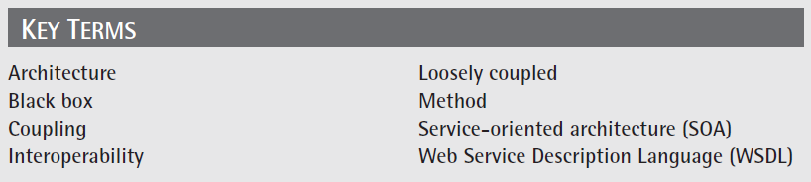
Key Terms

Slide 21
Chapter Review
Define software architecture.
Define and describe SOA.
Compare and contrast a web page and a web service.
Search the Web for companies that offer web services and then describe three to five web services that programmers might integrate into the applications they create.
Discuss what it means for a web service to be interoperable.

