Slide 1
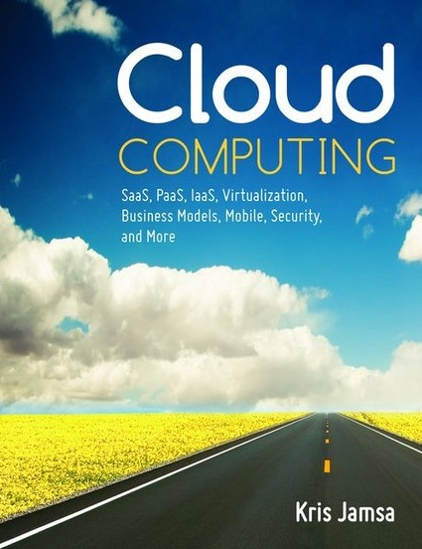

Cloud Computing
Chapter 10
Disaster Recovery and Business
Continuity and the Cloud

Slide 2
Learning Objectives
Define and describe business continuity.
Define and describe disaster recovery.
Describe the benefits of cloud-based or off-site backups.
Evaluate the risk of various threats and discuss steps to mitigate each.
Discuss the role of colocation as a business continuity and disaster recovery solution.
Identify and discuss a variety of system threats.
Describe the benefits of a cloud-based phone system.
Describe the benefit of cloud-based data storage to business continuity.
Describe the importance of testing/auditing the business continuity and disaster recovery plan.
Create a business continuity and disaster recovery plan.

Slide 3
Thread Disk Failure
Disk drives are mechanical devices, and as such they will eventually wear out and fail.
Further, other threats, such as fire, flood, theft, or power surges, can result in the loss of disk-based data.

Slide 4
Understanding MTBF
All mechanical devices have an associated mean time between failure (MTBF) rating. For a disk drive, the MTBF may be 500,000 hours of use (about 8 years).
It is important that you understand how manufacturers calculate the MTBF.
To start, the manufacturer may begin running 1000 disk drives. When the first disk drive fails, the manufacturer will note the time—let’s say after 500 hours (less than a month).

Slide 5
Understanding MTBF Continued
The manufacturers then multiply that time by the number of devices that they tested to determine the MTBF:
    MTBF = (500) × (1000)
    = 500,000 hours
It’s important to note that no device in the group ran near the 500,000 hours!

Slide 6
Reducing Disk Failure Threat
The first and foremost risk mitigation for disk failure is to have up-to-date disk backups.
If a disk fails, the company can simply replace the disk and restore the backup.
That implies, of course, that the cause of the disk failure (fire, smoke, flood, or theft) did not also damage the disk backup.
To reduce such risk, most companies store their disk backups at an off-site storage facility.

Slide 7
Real World: Iron Mountain
Since 1951, many companies have used Iron Mountain to store the tape backups securely. If the company ever needs to restore a disk or retrieve an archived letter, e-mail, or other data for legal or compliance reasons, the company can simply retrieve and restore the magnetic tape.

Slide 8
Iron Mountain Continued
Today Iron Mountain provides a variety of services beyond digital tape storage:
  Document management
  Cloud-based automatic backups
  Records management and storage (including health records)
  Secure document shredding
  And more

Slide 9
Disk Replacement: The Problem
The problem with the remote tape backup system is that it takes time.
To start, the company may need to purchase a replacement disk.
Then the company must install and format the disk for use.
Finally the company’s tape storage facility must locate and return the tape that contains the data.

Slide 10
RAID Disk Systems
Many data centers use of a redundant array of independent (or inexpensive) disks (RAID) to reduce the impact of disk failure. A RAID system contains multiple disk drives.
Rather than simply store a file on one drive, the RAID system stores the data across several drives along with data that can be used to reconstruct the file if one of the drives fail.

Slide 11
RAID Disk Systems Continued
If a disk drive fails, no file recovery is required from the tape backup. Instead, the IT staff can simply replace the failed disk and the RAID system will rebuild the disk’s contents on the fly!

Slide 12
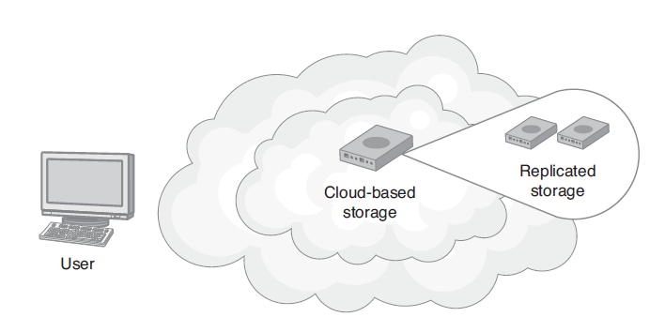
Cloud-Based Disk Storage
Most cloud-based data storage facilities provide automatic data replication to another cloud-based data repository.

Slide 13
Cloud-Based Data Backups
Because cloud-based backups reside at a remote storage facility, the backups immediately introduce a level of protection.
Because the backup files are immediately available from any device, anywhere, the backups reduce potential downtime because no time is needed to find, retrieve, and restore a tape backup from a traditional backup storage facility.

Slide 14
Power Threats
Computers are sensitive electronic devices. When a computer loses power, the user’s current unsaved data is lost.
Further, an electrical spike can permanently damage the computer’s electronic components, rendering the device unusable or destroying disk-based data.

Slide 15
Power Threats Continued
Although power blackouts can be caused by storms, accidents, or acts of terrorism, the more common power brownout is typically more damaging.
Unfortunately, power brownouts can be quite common, especially in the hot summer months when electrical demands spike.

Slide 16
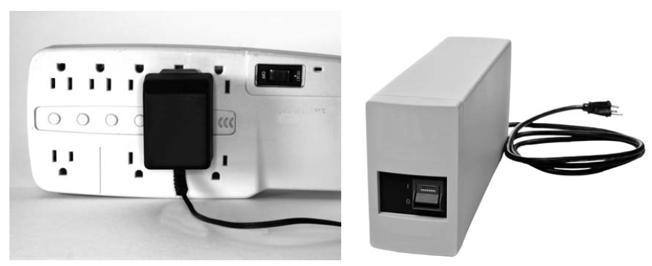
Uninterruptible Power Supply (UPS)
Users plug devices into surge suppressors to protect the devices from power spikes.
A UPS provides users with a few minutes of battery backup power so the users can save their work and shut down their systems in an orderly way.

Slide 17
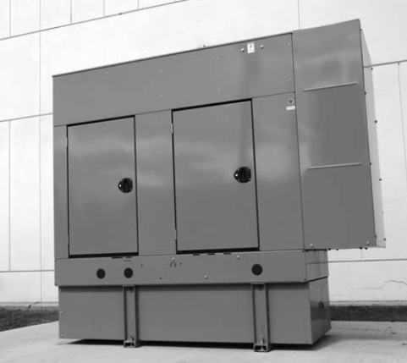
Diesel-Powered Generators
Many data centers have diesel-powered generators to produce power in the event of a long-term outage.

Slide 18
Cloud-Based Power Loss Risk Mitigation
When you consider the expensive infrastructure needed to reduce the impact of power interruption, that alone should make you consider housing your data center off-site within the cloud.
Most PaaS and IaaS solution providers have effectively dealt with power loss issues.
Remember, such providers can share the infrastructure costs across many customers. Also, most of the providers have colocated facilities on different power grids.

Slide 19
Threat: Computer Viruses
As users surf the web (potentially downloading and installing software) and share drives (such as junk drives), their systems and those in the same network are at risk for a computer virus attack or spyware.
It is estimated that within the United States alone, lost productivity time due to computer viruses exceeds $10 billion per year!

Slide 20
Computer Viruses Continued
The best defense against computer viruses and spyware is to ensure that every system has antivirus software installed.
Most antivirus solutions today automatically update themselves across the web, as often as daily, with the most recent virus and spyware signatures.

Slide 21
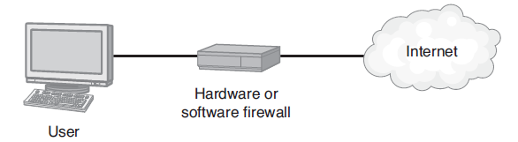
Firewall Protection
Home computer users and business users should protect their systems by placing a firewall between the systems and the Internet.

Slide 22
Other Virus Protection Steps
Many organizations prevent users from installing their own software.
Not only does this practice reduce the chance of a computer virus infection, it also aids the company in preventing the installation of software that the company does not own.
Companies must train users to not open e-mail attachments in messages they receive from users they do not know.

Slide 23
Threat: Fire
Fire can damage computer resources, data stored on disks, and local copies of system backups. If the fire itself does not damage the equipment, the smoke or the process of putting out the fire will.
Most offices have sprinkler systems, which, as you can imagine, destroy computers when they deploy. Often there is no good way to protect office hardware other than simply to insure it.

Slide 24
Halon-Based Fire Systems
Within a data center, you normally won’t find sprinkler systems, but rather halon systems, based on compounds of carbon and one or more halogens, that stop fire by removing all the oxygen from the room.

Slide 25
Cloud-Based Fire Suppression
If you house your data center in the cloud, your system will reside in a state-of-the-art data center that provides fire suppression systems and, in most cases, colocated system redundancy.
Again, because the PaaS and IaaS solution providers share their costs across many customers, they are able to provide their customers with top-level service at a relatively low cost.

Slide 26
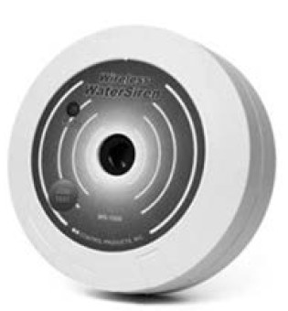
Threat: Floods
As with fire, so with flood: the best defense is to have current backups and insured equipment.
Within many data centers you will find flood sensors which sound an alarm if water is detected.
These sensors do not exist to detect widespread flooding, but rather water leaking from an on-site pipe break.
The new rule of thumb is to not select a PaaS or IaaS provider located in a flood zone.

Slide 27
Threat: Disgruntled Employees
A disgruntled employee can harm a company by launching a computer virus, changing or deleting files, or exposing system passwords.
It is very difficult to defend completely against a disgruntled employee, particularly one who has physical access to systems.

Slide 28
Disgruntled Employees Continued
For companies that use single-sign-on solutions, should the company terminate an employee, the company can quickly disable the employee’s access to all systems by simply disabling the employee within the authentication server.

Slide 29
Threat: Lost Equipment
Each year, within airports alone, thousands of notebook computers are lost or stolen.
When an employee loses a notebook, not only is the computer lost, but also the user’s local data, which may be confidential.
Today, with users carrying powerful handheld devices, the opportunity for loss becomes greater.
Given the amount of information a user stores on such a device, identity theft often follows the theft of a device.

Slide 30
Reducing Risk of Lost Equipment
To reduce the risk of data loss when a device is lost or stolen (or broken), the user must maintain current backups.
Typically, the more a company utilizes the cloud, the less risk the company will have with respect to a lost device.
If, for example, the user stores (or syncs) key files to a cloud-based data repository, the user is likely to lose only minimal data.

Slide 31
Threat: Desktop Failure
Computers, like all devices, may eventually wear out and fail. The cause of failure may be a bad disk drive, motherboard, power supply, and so on. The bottom line is that a user is now without a system.
The first step in recovering from a desktop failure is to ensure that current backups of the user’s files exist.

Slide 32
Reducing Risk through Virtualization
If a company delivers the users’ desktops on demand, a user whose system has failed need only stand up, walk to another system, and log in. The employee can then resume work right where he or she left off.
Further, if the user stores files in the cloud, he or she can likely access them from any device, and, if necessary, use software such as Office Web Apps to access and edit the files.

Slide 33
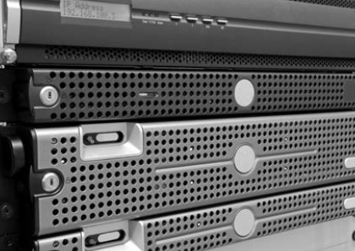
Blade Server Failure
Just as desktop computers can fail, so too can servers.
Blade server replacement is normally fast and simple. Because most servers boot from a NAS device, only minimal software setup is normally required.

Slide 34
Threat: Network Failure
For home computer users, when a network fails, users are going to be offline until a fix is applied. As a solution, some users are purchasing 3G and 4G wireless hotspot devices as a backup method of accessing the Internet.
To avoid the network from becoming a potential single point of failure, some companies bring in a second Internet source from a vendor other than their primary ISP.

Slide 35
Database System Failure
Most companies today rely on database management systems to store a wide range of data, from customer data, to human resources data, to application specific data.
If a company’s database fails, many applications may also fail.

Slide 36
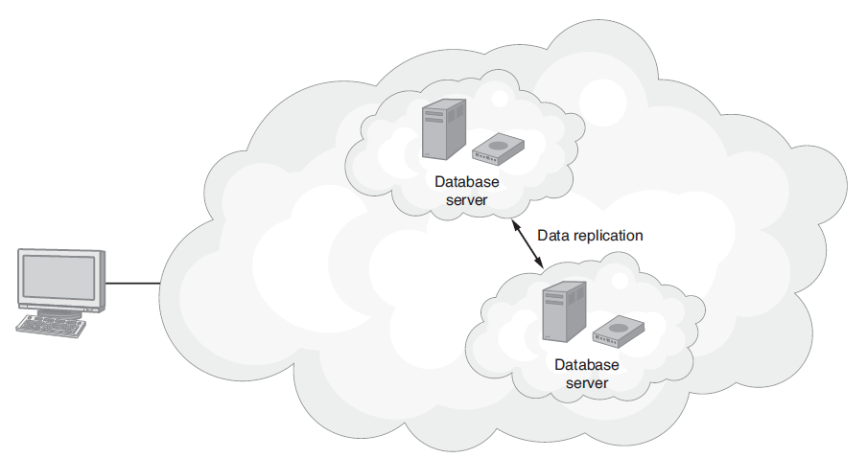
Reducing Risk of Database Failure
Database replication creates two live copies of databases on separate servers. If one database fails, the other can immediately take over operations.

Slide 37
Threat: Phone System Failure
Historically, there have been few ways outside of redundancy to reduce the impact of a phone system failure. That was the case until the advent of cloud-based phone systems.
To avoid a single point of failure for phone systems, cloud-based phone systems have now emerged. The cloud-based systems provide the functionality of a traditional phone system and, behind the scenes, provide system replication.

Slide 38
Real World: RingCentral
A cloud-based phone system provider featuring:
  Free nationwide calling and faxing
  Support for existing phones and faxes as well as RingCentral IP phones
  Lets users place calls from any phone, anywhere, appearing to be made from the usual office number
  Caller greetings customized by the time of day
  Fully customizable call forwarding
  Forwarding of voice mail and faxes to e-mail
  A phone directory system
  Ability to let companies deliver music or corporate messaging to callers who are on hold

Slide 39
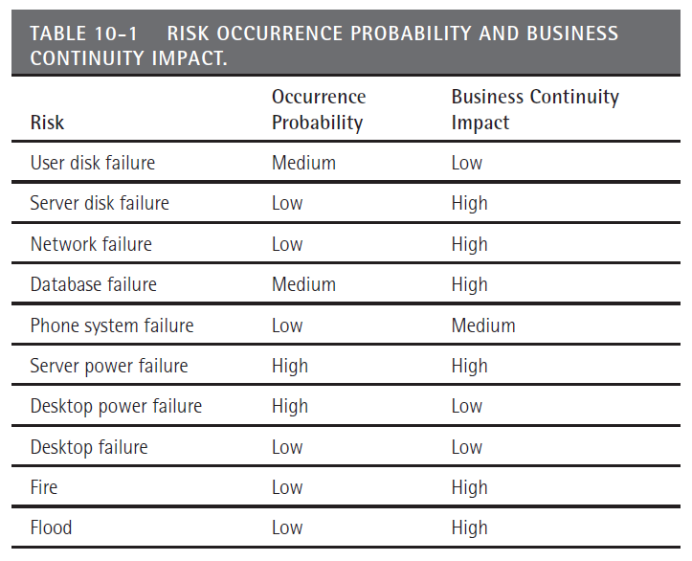
Risk Mitigation
To start the risk mitigation process, make a list of the company’s potential technology risks. Then estimate each risk’s potential for occurrence and its business continuity impact.

Slide 40
Disaster Recovery
Disaster recovery describes the steps a business will take to restore operations in the event of a disaster (fire, flood, hurricane, tornado, or other event).
By integrating cloud-based solutions, many companies have significantly reduced the cost of their business continuity programs while simultaneously reducing potential risks.

Slide 41
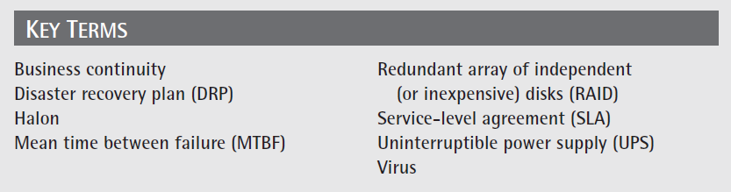
Key Terms

Slide 42
Chapter Review
Define and describe business continuity.
Define and describe disaster recovery.
Discuss pros and cons of cloud-based backup operations.
Discuss threats to an IT data center infrastructure and provide cloud-based solutions to mitigate the risks.
Create a DRP for a company with which you are familiar.

