Slide 1
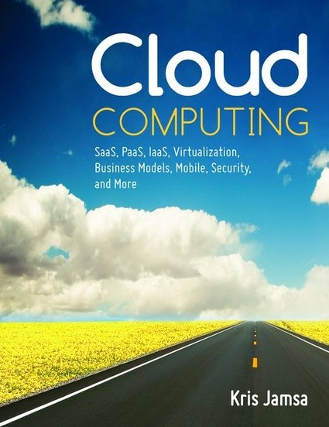

Cloud Computing
Chapter 8
Virtualization

Slide 2
Learning Objectives
Define and describe virtualization.
Discuss the history of virtualization.
Describe various types of virtualization.
List the pros and cons of virtualization.
Identify applications that are well suited, as well as those that are not suited, for virtualization.
Describe why companies should employ virtualization.

Slide 3
Virtualization Defined
The use of hardware and software to create the perception that one or more entities exist, although the entities, in actuality, are not physically present.
Using virtualization, we can make one server appear to be many, a desktop computer appear to be running multiple operating systems simultaneously, a network connection appear to exist, or a vast amount of disk space or a vast number of drives to be available.

Slide 4
Server Virtualization
Making one server appear as many. Each virtual server may run the same or different operating systems.
Server virtualization provides greater CPU utilization, a smaller equipment footprint, less power consumption, and support for multiple operating systems.

Slide 5
Desktop Virtualization
Allows a user to switch between multiple operating systems on the same computer. (An operating system that resides within a virtualized environment is known as a guest operating system.)
Some desktop virtualization techniques can provide an operating system environment on demand.
Desktop virtualization provides support for multiple operating systems, which is very convenient for software developers, testers, and help desk support staff.

Slide 6
Virtual Networks
Create the illusion that a user is connected directly to a company network and resources, although no such physical connection may exist.
Virtual networks are sometimes called virtual private networks or VPNs. Using a VPN, users can connect to a network and access the network resources from any Internet-connected computer.
Virtual networks let network administrators to segment a network, making different departments such as management, development, and sales appear to have their own separate networks.

Slide 7
Virtual Storage
Provides users (and applications) with access to scalable and redundant physical storage through the use of abstract, or logical, disk drives or file systems, or a database interface.

Slide 8
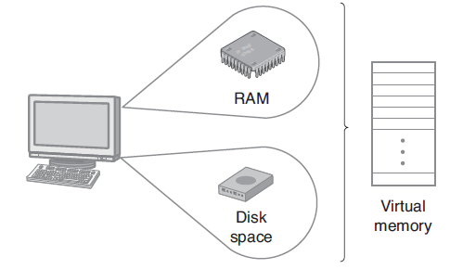
Virtual Memory
Virtual memory combines RAM with a page file on disk to create the illusion, to running programs, of the existence of a vast amount of RAM.

Slide 9
Advantages of Virtual Memory
A running program (process) appears to have unlimited memory.
The operating system can easily manage several different programs, running at the same time, and keep each program’s data and instructions secure.
The operating system can take advantage of disk storage, which is considerably less expensive than RAM.

Slide 10
Disadvantage of Virtual Memory
The disadvantage of virtual memory is that the paging process (the process of moving instructions and data between RAM and disk) adds overhead, mostly because disk drives are much slower than RAM.

Slide 11
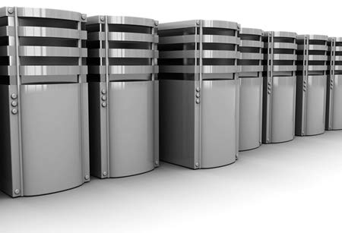
Original Servers
Server computers originally required their own chassis, disk, power supply, and fan. Servers consumed considerable power, took up considerable space, and generated considerable heat within the data center.

Slide 12
Green Computing
Power off devices when they are not in use.
Power up energy-intensive devices, such as laser printers, only when needed.
Use notebooks when possible instead of desktops.
Use the computer’s built-in power management features.
Minimize unnecessary printing.
Dispose of e-waste (devices, ink cartridges, monitors, and so on) in compliance with government regulations.

Slide 13
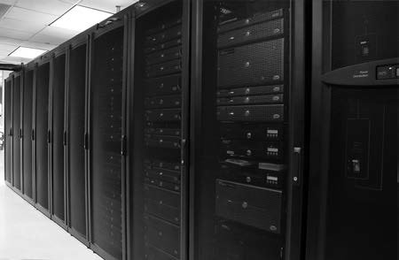
Blade Servers
The blade server is designed to fit within a rack with other blade servers. This reduces the server’s physical footprint, makes the server easier to cool, and reduces the server’s power consumption.

Slide 14
The Problem
Most servers today are either very busy, running at a high level of CPU utilization, or are idle a significant portion of the time, waiting for something to do.

Slide 15
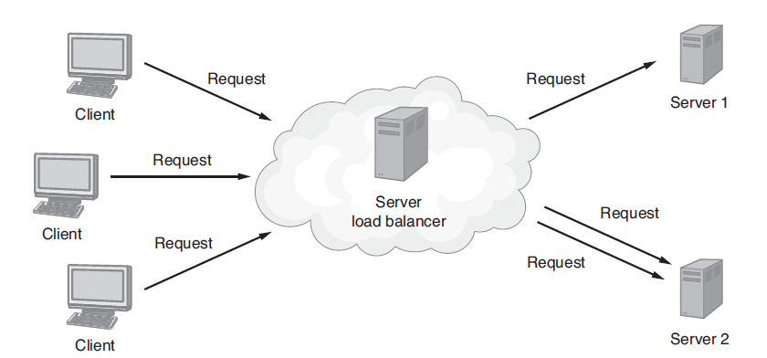
Load Balancing
Using load balancing, the IT staff can supply the number of servers necessary to meet the server workload at a given time.

Slide 16
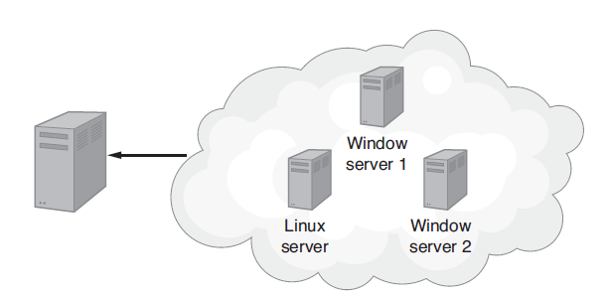
Server Virtualization
Through virtualization, a single physical server can be made to look like multiple separate servers, potentially running different operating systems.

Slide 17
Microsoft Hyper-V
Microsoft servers now utilize an underlying technology the company refers to as Hyper-V to allow administrators to create virtual servers.

Slide 18
Advantages of Hyper-V
The ability to consolidate servers and increase CPU utilization
Enhanced business continuity and disaster recovery
Ease of deploying testing and support environments
Enhanced support for Windows-based client virtualization
Improved load balancing
Ability to move live virtual machines from one physical server to another on the fly for load balancing and scalability

Slide 19
VMware ESXi
VMware is one of the best-known providers of virtualization solutions. For companies that need to support multiple operating systems within a virtual-server environment, Vmware ESXi provides the solution.

Slide 20
VMWare ESXi Continued
ESXi provides the following:
Support for multiple operating systems
Server consolidation
Automated resource management to drive disaster recovery and service-level agreements
Detail cost-reporting services
Automated load balancing
Centralized management and administration of virtual servers and the underlying machines

Slide 21
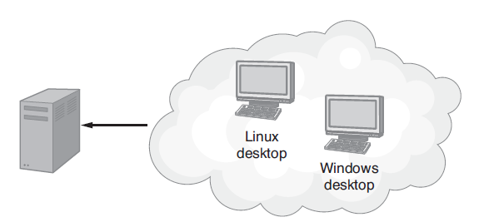
Virtual Desktop
The term for a desktop computer that runs two or more operating systems.

Slide 22
Virtual Desktop Continued
Desktop virtualization allows a desktop computer to run two or more operating systems at the same time and allows a user to quickly switch between the systems.

Slide 23
Advantages of Virtual Desktops
A single desktop computer can simultaneously run multiple operating systems.
There is reduced need for duplicate hardware.
Less power is consumed.

Slide 24
Microsoft Desktop Virtualization Tools
Microsoft Virtual Desktop Infrastructure (VDI) suite
Microsoft Application Virtualization (App-V)
Microsoft Enterprise Desktop Virtualization (MED-V)
Microsoft Remote Desktop Services (RDS)
Microsoft User State Virtualization (USV)
Windows Thin computer

Slide 25
VMware View
A tool for providing virtual desktops on demand. Using View, system administrators can centralize the on-demand delivery of an operating system and user-assigned applications.

Slide 26
Advantages of VMware View
Simplified desktop operating system and application management
Automated desktop provisioning (account generation)
Virtual-desktop image management
Support for a variety of client platforms

Slide 27
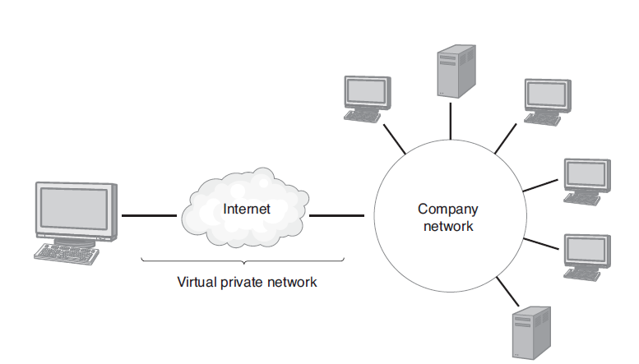
Virtual Private Network (VPN)
VPN software uses a secure Internet connection to give the user the illusion that he or she is physically connected to the remote network from his or her current location.

Slide 28
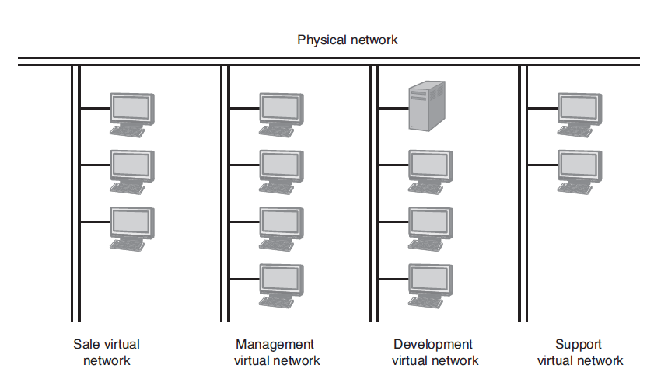
Virtual Network
Virtual local-area network (VLAN), which uses special routers to segment part of the physical network in such a way that the group appears to have its own private network.

Slide 29
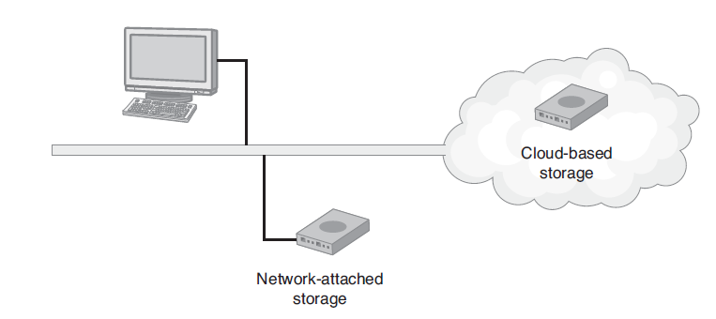
Data Storage Virtualization
Data storage virtualization hides the physical storage device or devices from the logical presentation that users or applications use to access the space.

Slide 30
Advantages of Cloud-Based Storage
Scalable disk storage space on demand
The ability to pay as you go for the needed storage
Behind-the-scenes backup and data replication
Support for common operating systems
Access from anywhere, anytime, and essentially any device
Ease of document sharing

Slide 31
Disadvantages of Cloud-Based Storage
Some users are not comfortable with their data residing in the cloud.
Cloud-based file access is slower than local file access due to network overhead.

Slide 32
Not All Applications Are Appropriate for Virtualization
Applications with unique hardware requirements: If an application requires a unique device or hardware device driver, the virtualization software may be unable to support the device.
Graphics-intensive applications: If an application is graphics intensive, such as a 3-D modeling program, the virtual device drivers may slow down the I/O processing to an unacceptable level.

Slide 33
Motivation to Virtualize
Increased device utilization (particularly CPU utilization)
Decreased device footprint
Decreased power consumption
Simplified operating system and application administration
Ease of software provisioning and patch releases
Device and storage scalability
Increased user access to key resources

Slide 34
Motivation to Virtualize Continued
Increased flexibility in supporting multiple operating system environments
Improved use and management of software licenses
Improved utilization reporting, which leads to improved capacity planning
Improved disaster recovery and business continuity

Slide 35
Disadvantages of Virtualization
New staff or staff training may be required to understand the virtualization process.
Not all applications are well suited for virtualization.
The virtualization process adds slight overhead, which will make some applications run more slowly.

Slide 36
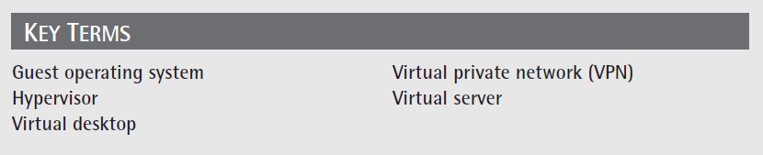
Key Terms

Slide 37
Chapter Review
Define and describe virtualization.
Defend the following statement: Virtualization is not a new concept within computer science.
Describe the various types of virtualization.
List the pros and cons of virtualization.
Discuss the attributes of applications that are not well suited for virtualization.

Slide 38
Chapter Review Continued
List reasons why companies should virtualize.
List the benefits of blade servers.
Define and describe the hypervisor.
Define and describe green computing.
Describe the concept of the desktop on demand, and include the benefits of such a system.

