Slide 1


Cloud Computing
Chapter 7
Collaboration in the Cloud

Slide 2
Learning Objectives
Define and describe collaboration.
Define and describe cloud-based collaboration.
List the benefits of cloud-based collaboration.
List and describe cloud-based tools for document sharing.
List questions that one should consider with respect to cloud-based collaboration tools.
Discuss the potential uses of cloud-based streaming media, from presentations to TV.

Slide 3
Collaboration Defined
The process of two or more people working together to achieve a result (a goal).

Slide 4
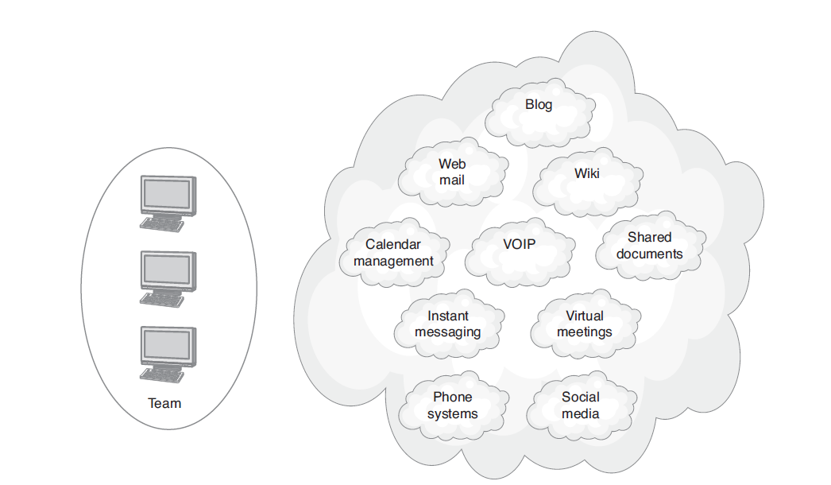
Cloud Collaboration Tools

Slide 5
Questions Regarding Cloud-Collaboration Tools
Can the solution scale to meet the organization’s future needs?
Is the solution secure?
What are the solution’s start-up and operational costs?
How will the solution impact the company’s IT staffing and resource requirements?
What are the solution’s learning curve and training requirements?

Slide 6
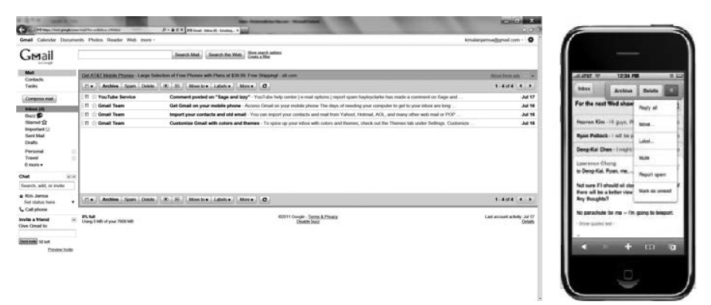
Device Support
Most web-based applications today, such as Google Gmail, support computer-based and handheld devices.

Slide 7
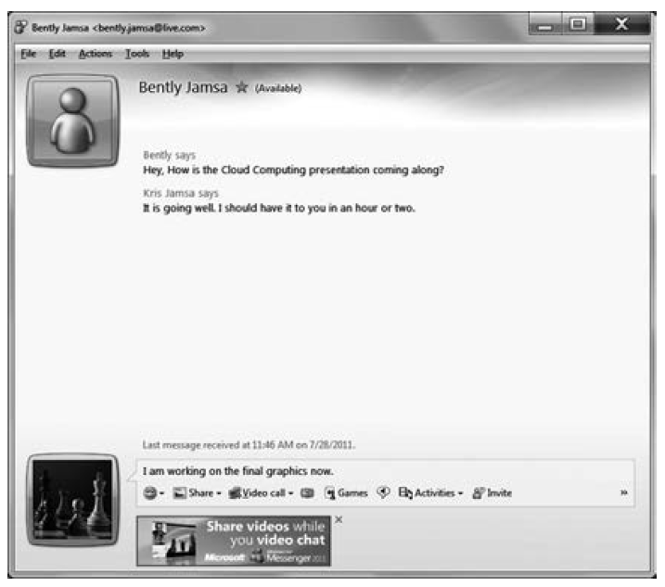
In the Beginning
The IM text-based interaction provided one of the web’s early forms of collaboration.

Slide 8
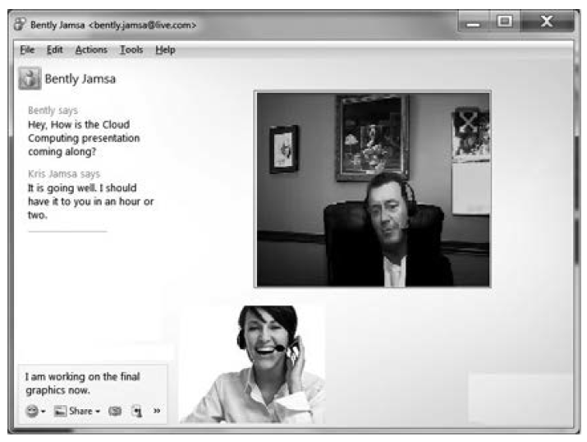
IM Today
IM tools have grown from a text-based medium for message exchange to support audio and video streaming.

Slide 9
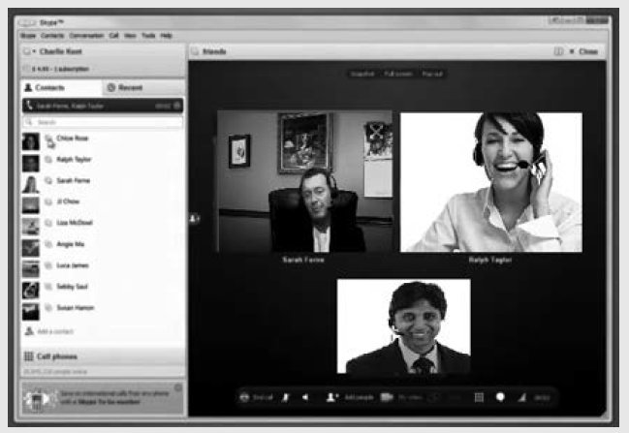
Real World: Skype
Integrates voice over IP (VoIP)
Supports conference calls

Slide 10
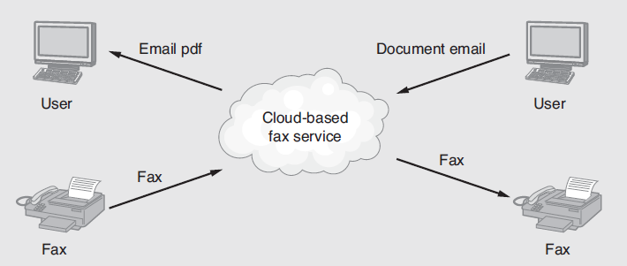
Faxing in the Cloud
Cloud-based fax services deliver faxes as PDF documents to a user’s e-mail.

Slide 11
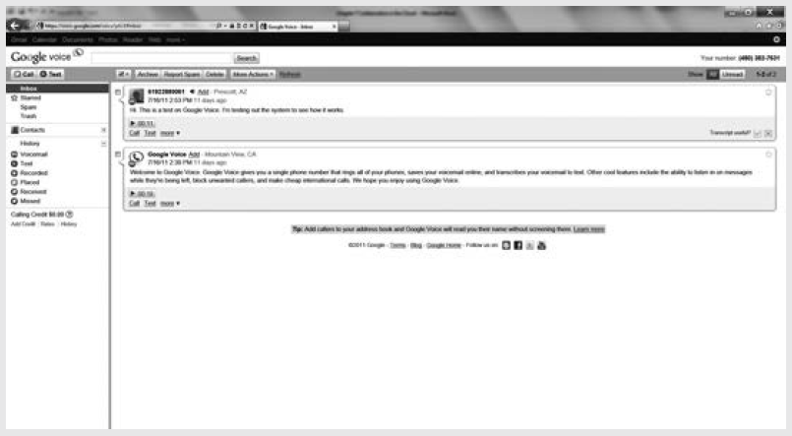
Real World: Google Voice
Google Voice provides you with a virtual phone account that you can forward to your phone. You can receive voice messages or direct Google Voice to transcribe the voice messages as text.

Slide 12
Wikis: Shared File Editing
Any member of the team can add or edit content.
Most users quickly learn how to edit content within the wiki.
Team members who edit the wiki content can reside anywhere.
The edits to wiki content are immediate.

Slide 13
Disadvantages of Wikis
Because any member can edit the content, wikis sometimes contain errors.
Public wikis are often targets of hacking and spam.
The wiki’s free-flowing format may lead to disorganized content.
Users are often suspicious of wiki content validity and accuracy.

Slide 14
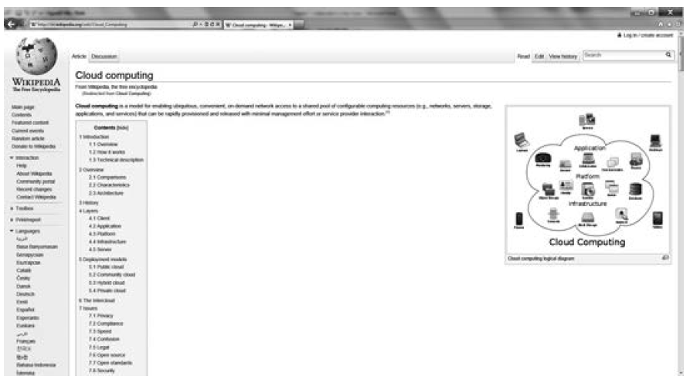
Wikipedia: “The Wiki”
Wikipedia provides the largest collection of web-based, user-contributed, and user-edited content.

Slide 15
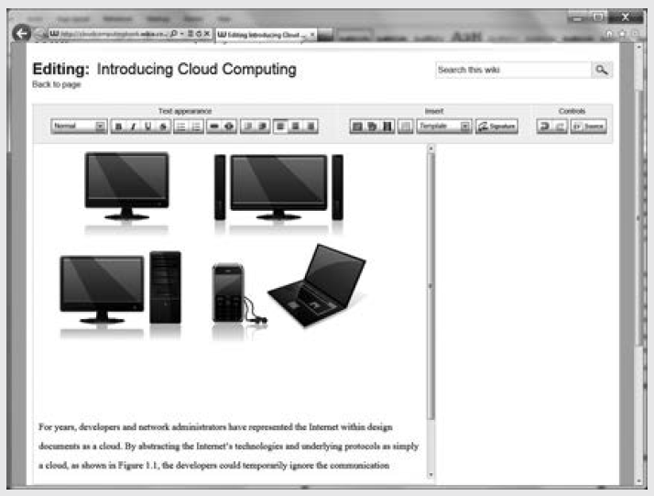
Real World: Wikia
Creating a cloud-based wiki, which discusses cloud-based topics and uses free software at Wikia.

Slide 16
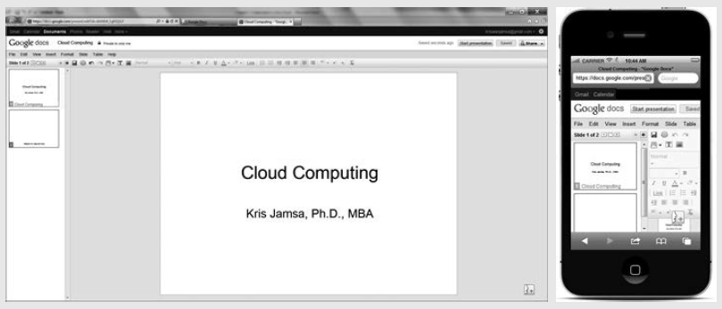
Real World: Google Docs
Google Docs provides users with web-based, free access to a word processor, spreadsheet, and presentation program—yes, Google Docs are meant to compete directly with the Microsoft Office tools.

Slide 17
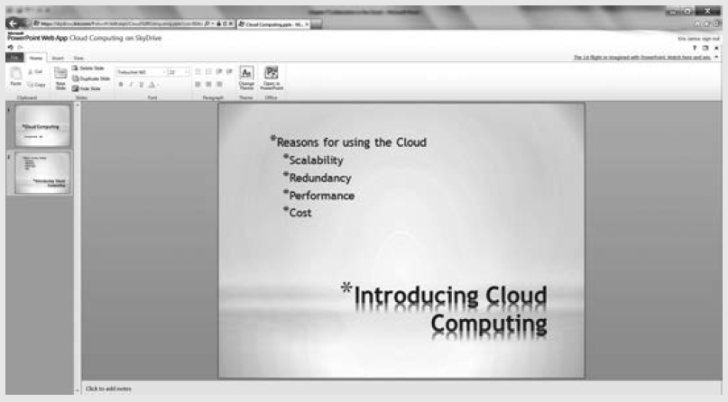
Real World: Microsoft Web Apps
Microsoft Office Web Apps lets users create and share (for simultaneous editing) cloud-based Word, Excel, and PowerPoint documents.

Slide 18
Collaborating with Web Logs (Blogs)
With the advent of Web 2.0, one of the most widely used communication tools has become the web log, or blog.
Blogs allow virtually anyone, with little or no web development experience, to easily publish content on the web.
Blogs can provide one-way or two-way communication—that is, some users post read-only content to blogs, while others allow readers to comment on the content.

Slide 19
Advantages of Blogs
Blogs provide a device-independent way for content consumers to access digital content using only a web browser.
Users can create and publish content to a blog with little or no web development experience.
Within an organization, intranet-based blogs provide a convenient way to disseminate information.
Blogs provide an effective way to collect feedback from readers.

Slide 20
Disadvantages of Blogs
Maintaining a blog takes time.
Blogs can become opinion posts as opposed to fact posts.
User feedback may not always be positive and may require moderation.

Slide 21
Collaborative Meetings in the Cloud
One of the biggest cost savers to businesses due to the cloud is the advent of the virtual meeting.
Using sites such as WebEx and GoToMeeting, businesses can now reduce travel costs through cloud-based meetings.

Slide 22
Advantages of Cloud-based Meetings
Streaming video that allows face-to-face interaction
Shared whiteboards that presenters can use to easily control the presentation of PowerPoint, Word, Excel, or related documents
Accessibility to users through a myriad of devices
Shared applications that let presenters easily dem software live within a controlled environment
The ability to hold company training online
The ability to record meetings for playback later

Slide 23
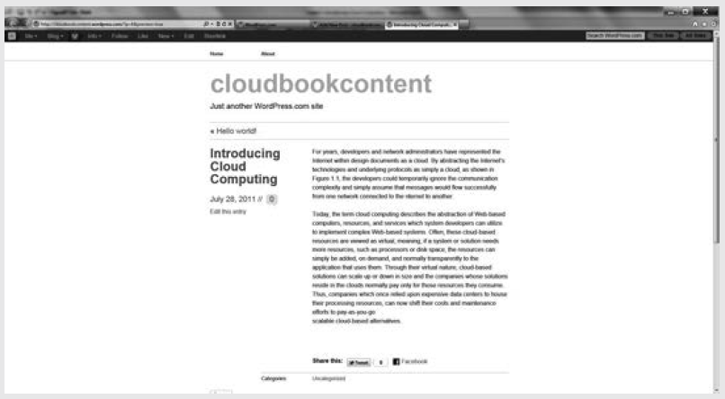
Real World: WordPress
Blogs provide users with no web development experience the ability to easily publish content on the web.

Slide 24
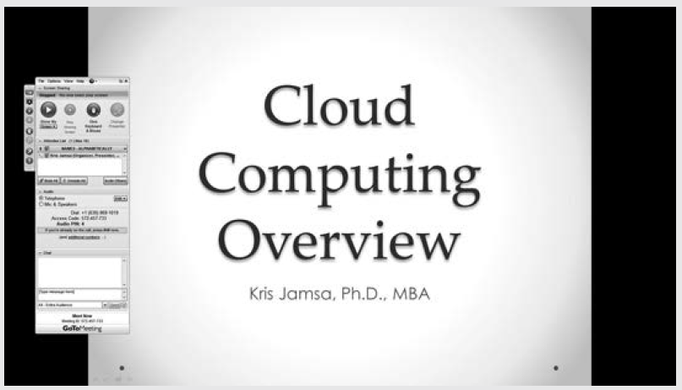
Real World: GotoMeeting
Virtual meetings allow companies to reduce expensive travel while maintaining the benefits of face-to-face interaction.

Slide 25
Advantages of Virtual Meetings
The costs of production and hosting for multimedia content are low.
Users can play back content at a time that best meets their needs and as often as they desire.
Companies can create a library of virtual marketing or training presentations.
Virtual presentation software is migrating to handheld devices.

Slide 26
Social Media Collaboration
Facebook is obviously the most successful Web 2.0 site.
Using Facebook, users communicate with friends to share photos, videos, and text messages.
Further, using Facebook groups, teams can share project information in a secure way.

Slide 27
Advantages of Social Media for Collaboration
Users can exchange project information from anywhere, anytime, with any device.
Groups can keep team content secure.
Most users are already familiar with the social media user interface.

Slide 28
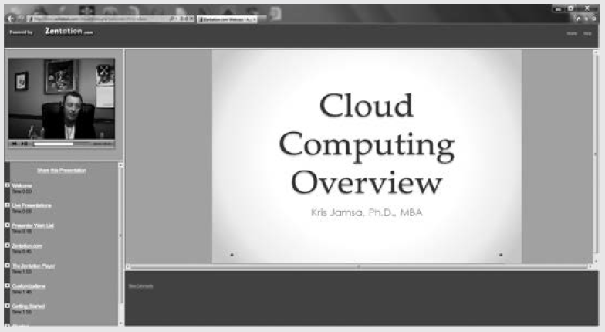
Real World: Zentation
Streaming a virtual presentation from the cloud.

Slide 29
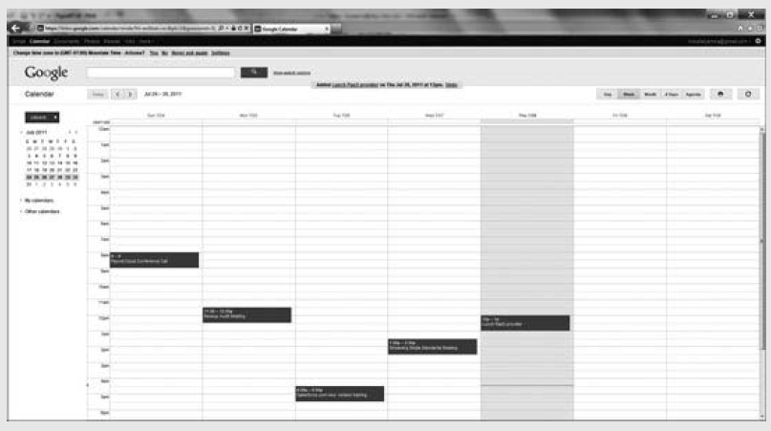
Real World: Google Calendar

Slide 30
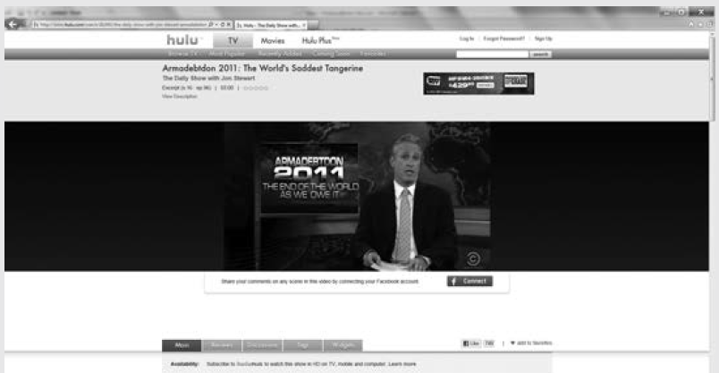
Real World: Hulu TV
Hulu is one company that is deploying streaming media content from the cloud, on demand.

Slide 31
Collaboration Summary
Use cloud-based conferencing software to present documents, share desktops, and benefit from face-to-face video.
Collaborate in real time and edit the same documents.
Share calendars to simplify appointment scheduling.
Use VoIP-based audio or video chats from anywhere with any device.

Slide 32
Summary Continued
Take advantage of virtual faxing services to send and receive faxes, without using a fax machine.
Forward transcripts of voice mail messages to their e-mail.
Communicate with team members using wikis and blogs.
Leverage familiar tools that are like social media for group interaction.
Stream media for marketing, training, or messaging purposes.

Slide 33
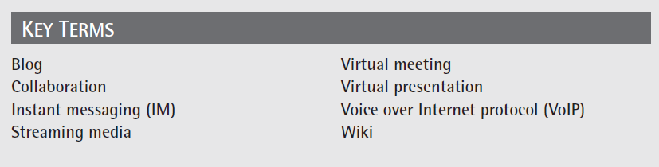
Key Terms

Slide 34
Chapter Review
Define collaboration.
Define and describe cloud-based collaboration.
The CIO of Ace Accounting Services suggests that the company can save considerable money using VoIP for phone calls. Define and describe VoIP. Then present three companies that provide VoIP offerings. Compare and contrast each company’s offering. Also, discuss whether or not you agree with the CIO and justify why.
List the questions one should consider when evaluating a cloud-based collaborative solution.

