Slide 1
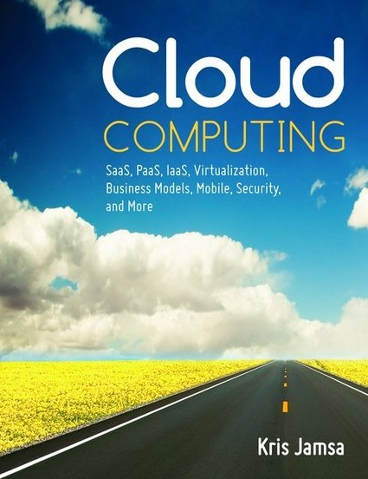

Cloud Computing
Chapter 5
Identity as a Service (IDaaS)

Slide 2
Learning Objectives
Describe challenges related to ID management.
Describe and discuss single sign-on (SSO) capabilities.
List the advantages of IDaaS solutions.
Discuss IDaaS solutions offered by various companies.

Slide 3
IDaaS Defined
Identity (or identification) as a service (IDaaS)—Cloud-based approaches to managing user identities, including usernames, passwords, and access. Also sometimes referred to as “identity management as a service.

Slide 4
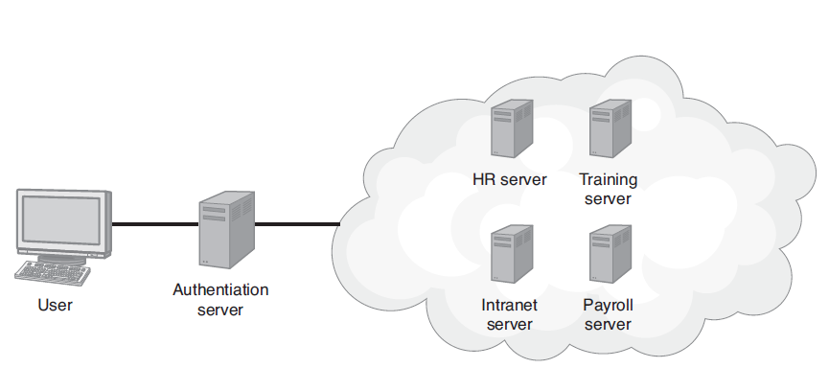
Single Sign-On (SSO)
Single sign-on (SSO)—PA process that allows a user to log into a central authority and then access other sites and services for which he or she has credentials.

Slide 5
Advantages of SSO
Fewer username and password combinations for users to remember and manage
Less password fatigue caused by the stress of managing multiple passwords
Less user time consumed by having to log in to individual systems
Fewer calls to help desks for forgotten passwords
A centralized location for IT staff to manage password compliance and reporting

Slide 6
Disadvantages of SSO
The primary disadvantage of SSO systems is the potential for a single source of failure. If the authentication server fails, users will not be able to log in to other servers.
Thus, having a cloud-based authentication server with system redundancy reduces the risk of system unavailability.

Slide 7
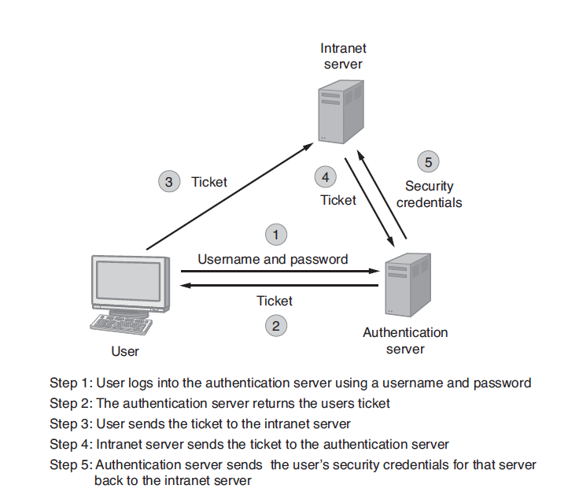
How SSO Works

Slide 8
Federated ID Management
FIDM describes the technologies and protocols that combine to enable a user to bring security credentials across different security domains (different servers running potentially different operating systems).

Slide 9
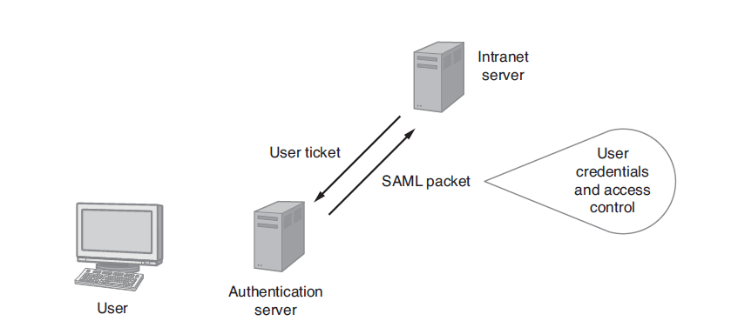
Security Assertion Markup Language (SAML)
Behind the scenes, many FIDM systems use the Security Assertion Markup Language (SAML) to package a user’s security credentials.

Slide 10
Account Provisioning
The process of creating a user account on a system is called account provisioning.
Because different employees may need different capabilities on each system, the provisioning process can be complex.
When an employee leaves the company, a deprovisioning process must occur to remove the user’s accounts.

Slide 11
Deprovisioning Problem
Unfortunately, the IT staff is not always immediately informed that an employee no longer works for the company, or the IT staff misses a server account and the user may still have access to one or more systems.

Slide 12
4 A’s of Cloud Identity
Authentication: The process of validating a user for on-site and cloud-based solutions.
Authorization: The process of determining and specifying what a user is allowed to do on each server.
Account management: The process of synchronizing user accounts by provisioning and deprovisioning access.
Audit logging: The process of tracking which applications users access and when.

Slide 13
Real World: Ping Identity IDaaS
Ping Identity provides cloud-based ID management software that supports FIDM and user account provisioning.

Slide 14
Real World: PassworkBank IDaaS
PasswordBank provides an IDaaS solution that supports on-site and cloud-based system access. Its FIDM service supports enterprise-wide SSO (E-SSO) and SSO for web-based applications (WebSSO).
The PasswordBank solutions perform the FIDM without the use of SAML.
PasswordBank solutions support a myriad of devices, including the iPhone.

Slide 15
OpenID
OpenID allows users to use an existing account to log in to multiple websites. Today, more than 1 billion OpenID accounts exist and are accepted by thousands of websites.
Companies that support OpenID include Google, Yahoo!, Flickr, Myspace, WordPress.com, and more

Slide 16
Advantages of Using OpenID
Increased site conversion rates (rates at which customers choose to join websites) because users do not need to register
Access to greater user profile content
Fewer problems with lost passwords
Ease of content integration into social networking sites

Slide 17
Mobile ID Management
Threats to mobile devices include the following:
  Identity theft if a device is lost or stolen
  Eavesdropping on data communications
  Surveillance of confidential screen content
  Phishing of content from rogue sites
  Man-in-the-middle attacks through intercepted signals
  Inadequate device resources to provide a strong security implementation
  Social attacks on unaware users that yield identity information

Slide 18
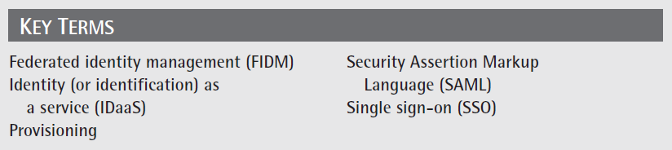
Key Terms

Slide 19
Chapter Review
1. Define and describe SSO.
2. Define and describe IDaaS.
3. Define SAML and describe its purpose.
4. Define and describe provisioning.
5. Define and describe FIDM.
6. List factors that make mobile ID management difficult.

