Slide 1
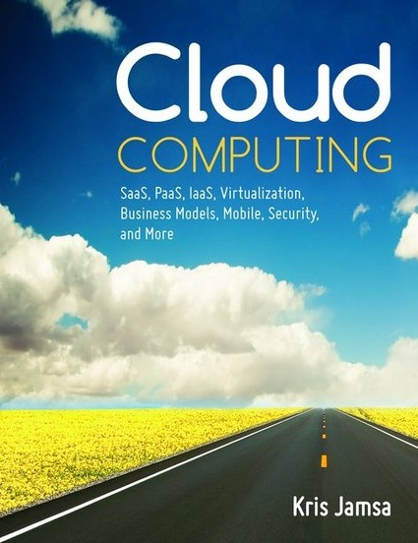
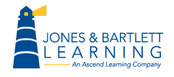
Cloud Computing
Chapter 4
Infrastructure as a Service (IaaS)

Slide 2
Learning Objectives
Define and describe IaaS and identify IaaS solution providers.
Define and describe colocation.
Define and describe system and storage redundancy.
Define and describe cloud-based network-attached storage (NAS) devices and identify solution providers.
Define and describe load balancing and identify cloud-based solution providers.
Describe the pros and cons of IaaS solutions.

Slide 3
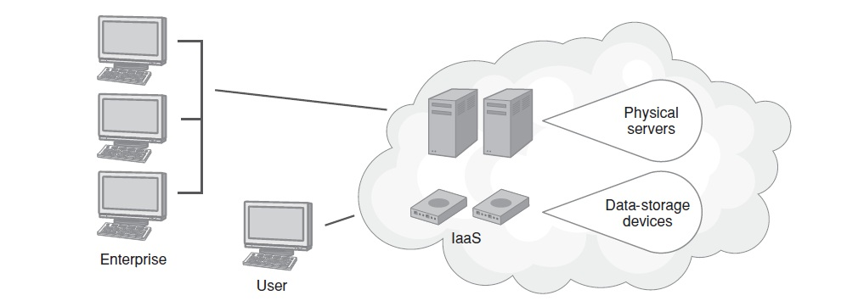
IaaS Defined
An IaaS provider makes all of the computing hardware resources available, and the customers, in turn, are responsible for installing and managing the systems, which they can normally do, for the most part, over the Internet.

Slide 4
What Data Centers Must Provide
Access to high-speed and redundant Internet service
Sufficient air conditioning to eliminate the heat generated by servers and disk storage devices
Conditioned power with the potential for uninterrupted power supply in the short term and long term through the use of on-site diesel powered generators
Fire suppression systems
Administrative staffing to support hardware, networks, and operating systems

Slide 5
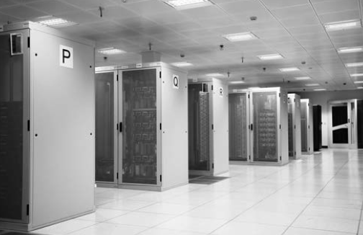
Bottom Line: Data Centers are Expensive

Slide 6
Colocated Data Centers
To reduce the risk of a single point of failure, companies often create a duplicate data center at a remote location.
Should one of the data centers fail, the other can immediately take over operations.
Unfortunately, the second data center will increase the company’s costs—essentially doubling them—because there are duplicate servers, storage devices, network equipment, Internet access, and staffing.

Slide 7
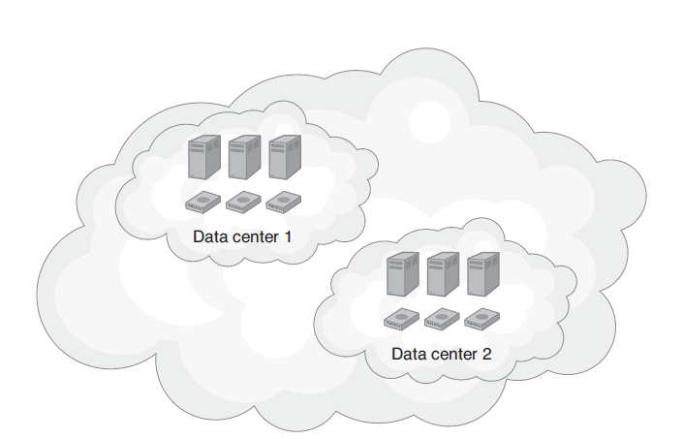
Colocated Data Center

Slide 8
What Colocated Systems Accomplish
Makes the company less susceptible to fire, acts of God, and terrorism
Improves performance through a distributed workload
Makes the company less susceptible to downtime due to power loss from a blackout or brownout

Slide 9
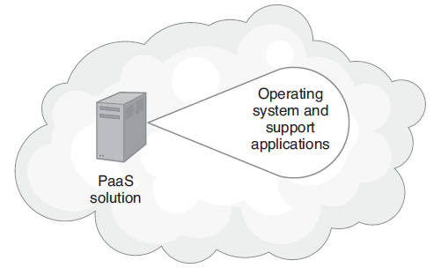
Role of a PaaS
PaaS solutions allow smaller companies to eliminate the need for their own on-site data center.

Slide 10
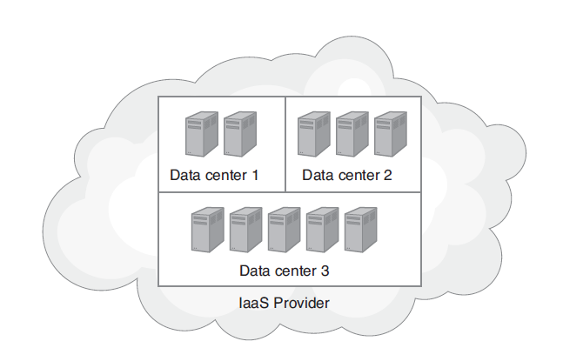
IaaS Solutions May Support Many Different Companies

Slide 11
Load Balancing
Across the web, sites experience a wide range of network traffic requirements.
Sites such as Google, Yahoo!, Amazon, and Microsoft experience millions of user hits per day. To handle such web requests, the sites use a technique known as load balancing, to share the requests across multiple servers.

Slide 12
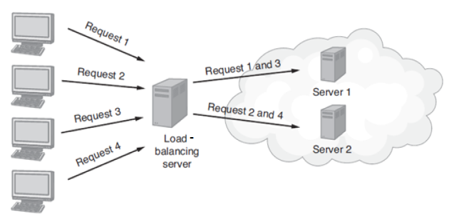
Load Balancing Continued
Load balancing uses a server to route traffic to multiple servers which, in turn, share the workload.

Slide 13
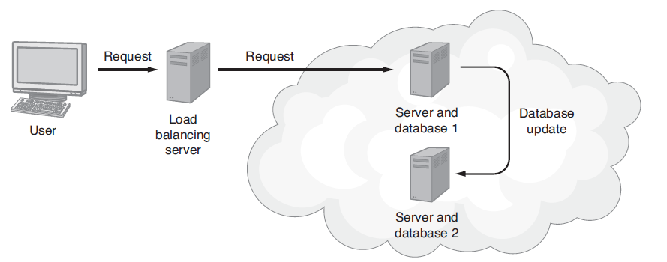
Load Balancing and Replicated Databases
Load balanced systems, for data redundancy, often replicate databases on multiple servers.
Each database, in turn, will send data updates to the other to maintain data synchronization between the servers.

Slide 14
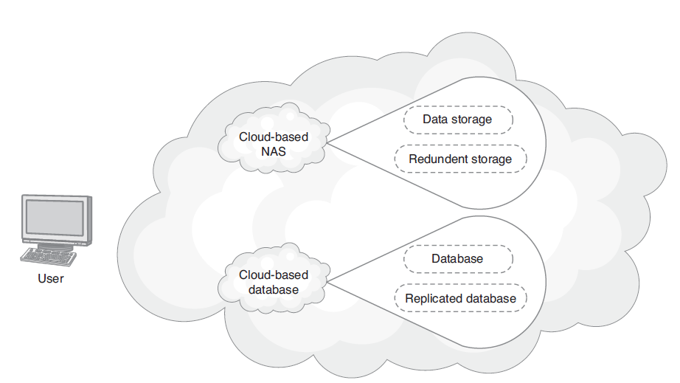
Cloud-Based Data Replication
Using cloud-based NAS devices and cloud-based databases, companies can replicate key data within the cloud.

Slide 15
Real World: Rackspace IaaS
Rackspace has emerged as one of the largest players in the IaaS market. Rackspace offers a set of solutions that include cloud hosting, managed hosting (including 24/7 data-center like management), and hybrid solutions that combine the cloud and managed services.
Within minutes, from the Rackspace website an administrator can select a solution that deploys from 1 to 50 servers. Larger configurations are available.

Slide 16
Rackspace Continued
Today Rackspace offers cloudbased solutions to hundreds of thousands of clients. Rackspace houses its data centers at very large facilities located around the world.
With respect to the cloud, Rackspace offers pay as you go scalability, with on-demand storage and load balancing. Beyond cloud hosting, Rackspace provides solutions for cloud-based e-mail, Exchange hosting, file sharing, backups, and collaboration.

Slide 17
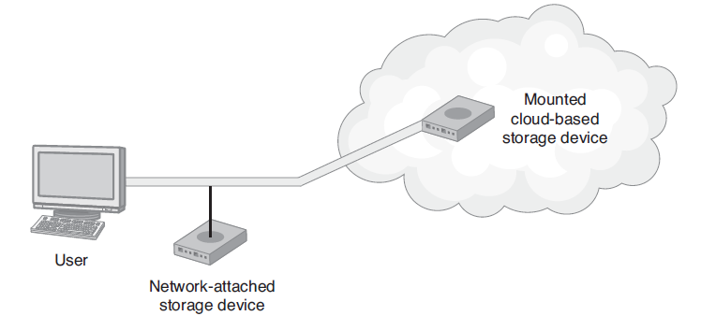
Network Attached Storage (NAS)
Cloud-based NAS devices present cloud-based storage as mountable devices, which may be replicated in the cloud to meet a company’s data redundancy needs.

Slide 18
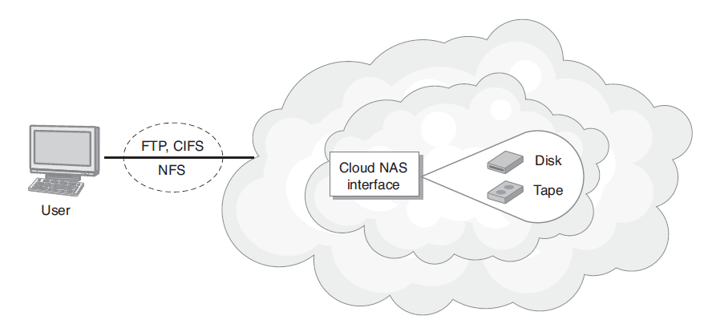
Real World: Nirvanix IaaS
The Nirvanix IaaS provides cloud-based NAS, which is accessible through the CloudNAS file system.

Slide 19
Advantages of IaaS
Elimination of an expensive and staff-intensive data center
Ease of hardware scalability
Reduced hardware cost
On-demand, pay as you go scalability
Reduction of IT staff
Suitability for ad hoc test environments
Allows complete system administration and management

Slide 20
IaaS Server Types
Physical server: Actual hardware is allocated for the customer’s dedicated use.
Dedicated virtual server: The customer is allocated a virtual server, which runs on a physical server that may or may not have other virtual servers.
Shared virtual server: The customer can access a virtual server on a device that may be shared with other customers.

Slide 21
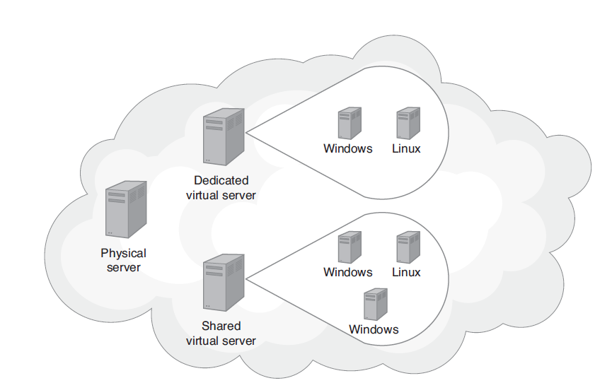
IaaS Server Types Continued
Within an IaaS environment, customers can allocate various server types.

Slide 22
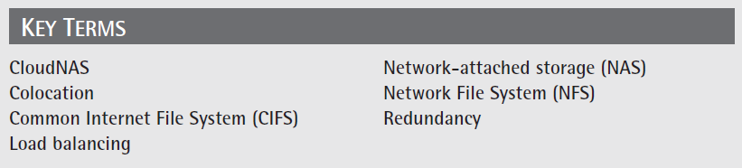
Key Terms

Slide 23
Chapter Review
1. Define and describe IaaS.
2. Define and describe system redundancy. Discuss how you might use IaaS to implement a redundancy plan.
3. Define and describe load balancing. Discuss how you might use IaaS to implement load balancing.

Slide 24
Chapter Review Continued
4. Define and describe NAS. Assume you must implement a shared file system within the cloud. What company would you select? Why? What costs should your client expect to pay for cloud-based data on a gigabyte (GB) basis?
5. Define and describe colocation. Discuss how you might use IaaS to implement colocation.
6. Compare and contrast a cloud-based disk storage device (with a file system) with a cloud based database.

Slide 25
Chapter Review Continued
7. Compare and contrast physical, dedicated virtual, and shared virtual servers. Search the web for companies that provide each. What cost should a customer expect to pay for each?

