Slide 1
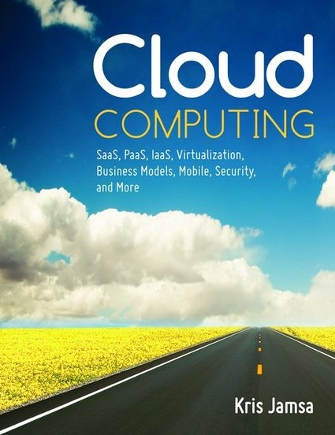

Cloud Computing
Chapter 3
Platform as a Service (PaaS)

Slide 2
Learning Objectives
Define and describe the PaaS model.
Describe the advantages and disadvantages of PaaS solutions.
List and describe several real-world PaaS solutions.
List and describe cloud-based database solutions and describe their advantages.
Discuss the development history that led to PaaS.

Slide 3
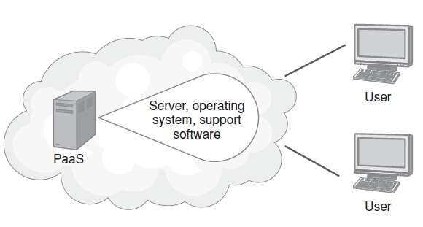
Platform as a Service (PaaS)
Provide a collection of hardware and software resources that developers can use to build and deploy applications within the cloud.
Depending on their needs, developers may use a Windows-based PaaS solution or a Linux-based PaaS.

Slide 4
PaaS Advantages
Developers eliminate the need to buy and maintain hardware, and the need to install and manage operating system and database software.
Because the computing resources no longer reside in the data center, but rather in the cloud, the resources can scale on demand and the company can pay for only resources it consumes.
Further, because PaaS eliminates the developers’ need to worry about servers, they can more quickly deploy their web-based solutions.

Slide 5
PaaS Disadvantages
Some developers and administrators want finer control over the underlying systems (versions, patch releases/applications, …)

Slide 6
Real World: Google App Engine
Google App Engine, sometimes called GAE, is a PaaS solution that lets developers create and host web-based applications that reside and run on services managed by Google.
Like many Google services and offerings, Google App Engine is a free service.
Google App Engine provides platform support for a variety of programming languages, the three most common of which are Java, Python, and Go.

Slide 7
Google App Engine Continued
Google App Engine features include the following:
Support for dynamic web pages
Data storage and query support
Load balancing for application scalability
Application program interface (API) support for application-based e-mail through Google services
A local development environment that simulates Google App Engine on the developer’s computer
Support for event scheduling and triggering
An application sandbox that limits access to the underlying operating system
An administrative console for managing applications

Slide 8
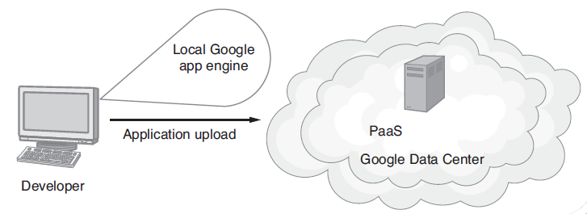
Google App Engine

Slide 9
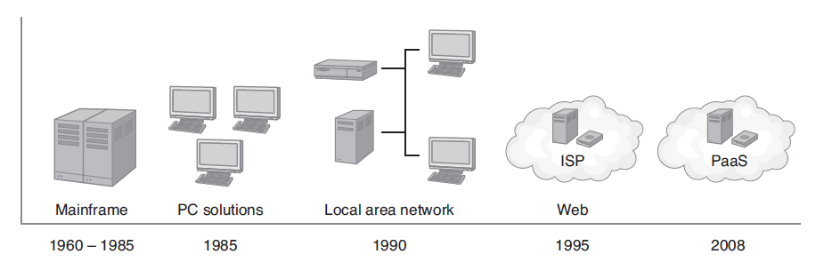
Evolution to the Cloud
Mainframe Computers
Personal Computers
Local-Area Networks
Internet Service Providers (ISPs)
PaaS

Slide 10
Mainframe Computing
Large capital investment for data-center-based computers
Large, expensive disk and tape storage systems that often provided only limited storage capacity
User interface to the system provided through dumb terminals
Limited computer–network interconnectivity
System security maintained through physical security (few users had direct access to the computer hardware)

Slide 11

Mainframe Computer

Slide 12

Tower-Based Servers
Large physical footprint
Considerable heat generation and power consumption

Slide 13
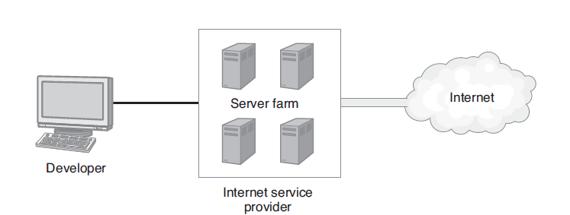
Internet Service Providers (ISPs)

Slide 14
ISP Advantages
Reduced cost: The ISP provided the high-speed, high-bandwidth Internet connection, which it shared across several companies.
Less server administration: The ISP managed the servers to which developers uploaded their solutions.
Less hardware to purchase and maintain: The ISP purchased and managed the hardware and managed the infrastructure software, such as the operating system.

Slide 15
ISP Advantages Continued
Greater system uptime: Through the use of redundant hardware resources, the ISP provided high system uptime.
Potential scalability: The ISP had the ability to move a high-demand application to a faster bandwidth connection.

Slide 16
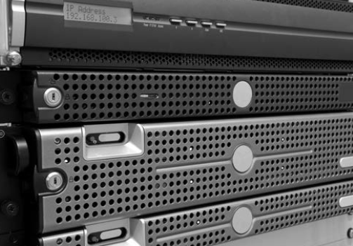
Blade Computers
Reduced server footprint
Reduced power consumption and heat generation

Slide 17
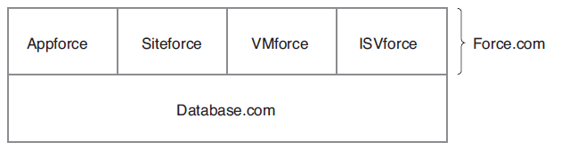
Real World: Force.com PaaS
To extend its cloud capabilities to application developers, Salesforce.com has released the Force.com PaaS.
Originally developed to provide a home for business applications, Force.com now runs applications across most sectors.

Slide 18
Benefits of PaaS
By shifting computing resources from an on-site data center to the cloud, PaaS solutions offer:
Lower total cost of ownership: Companies no longer need to purchase and maintain expensive hardware for servers, power, and data storage.
Lower administration overhead: Companies shift the burden of system software administration from in-house administration to employees of the cloud provider.

Slide 19
Benefits of PaaS Continued
More current system software: The cloud administrator is responsible for maintaining software versions and patch installations.
Increased business and IT alignment: Company IT personnel can focus on solutions as opposed to server-related issues.
Scalable solutions: Cloud-based solutions can scale up or down automatically based on application resource demands. Companies pay only for the resources they consume.

Slide 20
Disadvantages of PaaS
Potential disadvantages of PaaS solutions include:
Concerns about data security: Some companies are hesitant to move their data storage off-site.
Challenges to integrating cloud solutions with legacy software: A company may need to support on-site solutions as well as cloud-based solutions. Communication between the two application types may be difficult to impossible.
Risk of breach by the PaaS provider: If the company providing the PaaS service fails to meet agreed-upon service levels, performance, security, and availability may be at risk, and moving the application may be difficult.

Slide 21
Real World: Windows Azure as a PaaS
Microsoft .NET has driven the development of many dynamic web solutions and web services.
Windows Azure is a PaaS running within Microsoft data centers.
Users pay only for the scalable processor resources that they consume.
SQL Azure provides a cloud-based database solution for applications running within Windows Azure.

Slide 22
Windows Azure Continued
Windows Azure goes beyond .NET and includes support for Java, PHP, and Ruby. Developers can build and deploy their solutions to Azure using an IDE such as Visual Studio or Eclipse.
Developers can interface to SQL Azure using much of the same code they would use to access a local database.

Slide 23
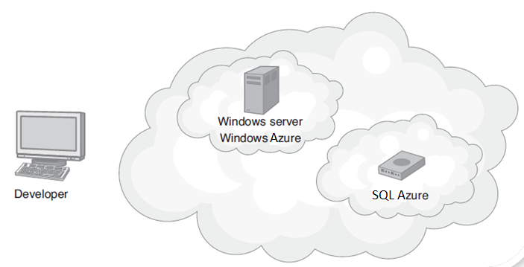
Windows Azure Continued

Slide 24
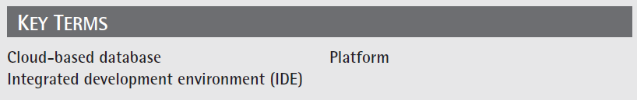
Key Terms

Slide 25
Chapter Review
1. Define and describe PaaS.
2. List the benefits of PaaS solutions.
3. Describe potential disadvantages of PaaS.
4. Describe how a cloud-based database management system differs from an on-site database.
5. List the computing resources normally provided with a PaaS.

Slide 26
Chapter Review Continued
6. Assume your company must deploy a .NET solution to the cloud. Discuss the options available to developers. Research the web and estimate the costs associated with deploying a PaaS solution.
7. Assume your company must deploy a PHP or Java solution to the cloud. Discuss the options available to developers. Research the web and estimate the costs associated with deploying a PaaS solution.

