Slide 1
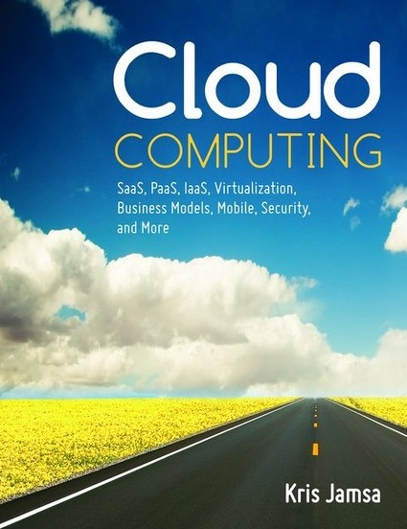

Cloud Computing
Chapter 2
Software as a Service (SaaS)

Slide 2
Learning Objectives
Define and describe SaaS.
List the advantages and disadvantages of SaaS solutions.
Define and describe OpenSaaS.
Define and describe mashups.
Discuss the wide range of SaaS solutions and their providers.

Slide 3
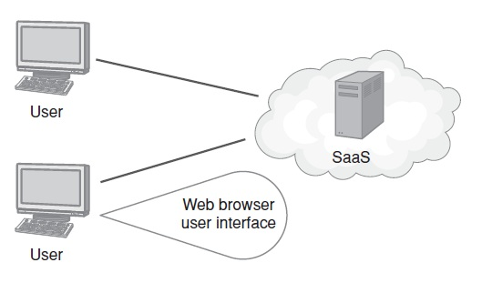
Software as a Service
SaaS Defined
A solution model in which users use a web browser to access software that resides, along with the programs and user data, in the cloud.

Slide 4
SaaS Advantages
Eliminate the need for an on-site data center.
Eliminate the need for application administration.
Allow customers to pay on demand for software use, normally on a per-user basis.
Offer application, processor, and data storage scalability.
Offer device-independent access to applications.
Increase disaster recovery and business continuity.

Slide 5
SaaS Disadvantages
The biggest concern, or potential disadvantage, is that the data, like the applications, reside in the cloud. Many companies are concerned about letting go of their data.
Also, because the company does not own the solution, it can be challenging or expensive to customize the application.

Slide 6
Real World: Salesforce.com
Cloud-based customer relationship management (CRM) solutions.
Companies accomplish the following:
  Manage sales contacts and leads
  Centralize contact information, presentations, and project details
  Access sales information and reports from anyplace, at any time, with any device
  Manage project quotes and project work flow
  Sync sales contacts and meetings with existing tools, such as Microsoft Outlook

Slide 7
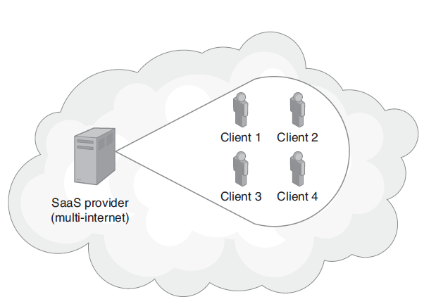
Multitenant SaaS Solutions
SaaS applications are often multitenant solutions; that is, within the cloud, two or more companies may share the same server resources.

Slide 8
Real World: Taleo Human-Resources SaaS
To achieve wide-scale use, an SaaS solution must have large market potential.
Every business must recruit, hire, train, and compensate employees.
The Taleo cloud-based talent management system provides applications and services to meet company human resources demands.

Slide 9
OpenSaaS Solutions
An OpenSaaS solution is an SaaS application created using an open-source programming language and designed to run on an open-source operating system and database.
Many customers believe that if a solution is open source, it will be easier for them to move the data to a different application in the future if the current solution fails to meet their needs.
Because customers do not own the SaaS software, they will not be able to move the application itself.

Slide 10
Real World: ADP SaaS-based Payroll Processing
One of the first companies to leverage the power of the cloud was ADP—a payroll processing company.
Reaching far beyond payroll today, ADP offers cloud-based solutions for time management, employee benefits processing, workers compensation, human resources issues, and more.
Further, ADP has extended many of its services to mobile users, allowing payroll processing to occur any time, from any place.

Slide 11
Real World: WebEx SaaS-Based Virtual Meetings
To gain market share, an SaaS solution must be disruptive; it must change its industry.
The WebEx solution not only changes how and when people meet, it disrupts the travel industry by reducing business trips, hotel stays, and business meals.
Millions of users rely on WebEx to provide a virtual yet face-to-face meeting platform. A side effect of less travel is the greening of business, which has less impact on the environment.

Slide 12
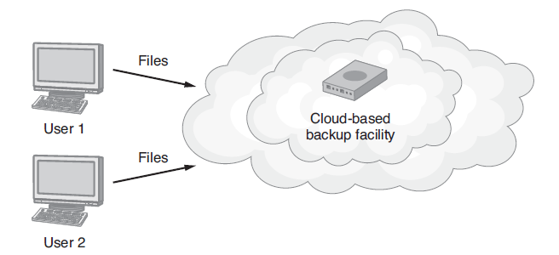
Real World: Carbonite SaaS-based Backups
Users know they should perform regular disk and file backup operations. Because the process is generally too time consuming, most users fail to back up their files on a regular basis.
Carbonite provides turn-key backups to the cloud.

Slide 13
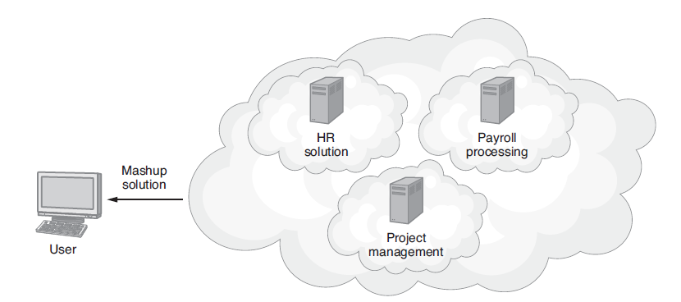
Understanding Mashups
A collection of services joined to create an overall solution.
Mashups can be combined by JavaScript or by a server-based application.

Slide 14
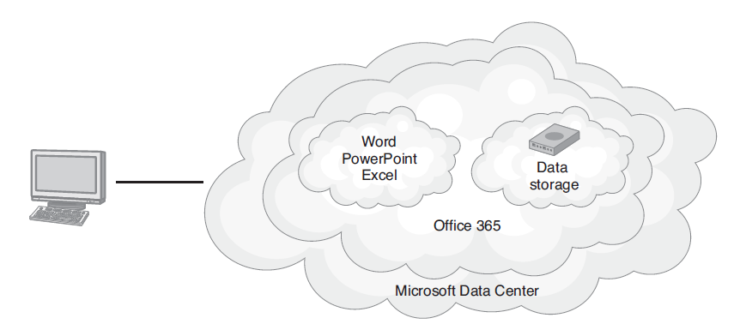
Real World: Office365
SaaS-Based Document Creation
Office 365 provides cloud-based subscription access to the Office suite of applications.

Slide 15
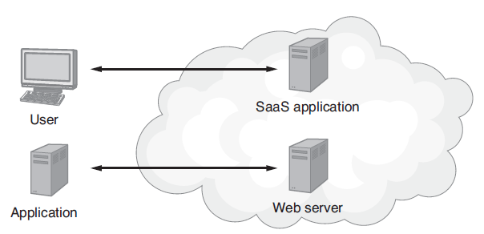
Introducing Service-Oriented Architecture (SOA)
Service-oriented architecture (SOA) is an application development methodology with which developers create solutions by integrating one or more web services.

Slide 16
Web Service
A function or subroutine a program can call to accomplish a specific task.
When a program running on one computer calls a web service, a message, possibly containing parameter values, is sent across the network (or Internet) to the computer housing the web service.
That computer, in turn, performs its processing and normally returns a result to the caller.
Some developers refer to web services as remote-procedure calls.

Slide 17
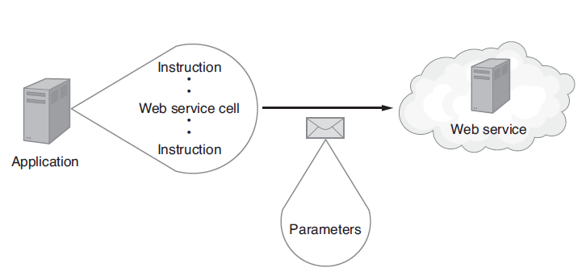
Web Service Message Passing

Slide 18
Web Services Continued
Developers refer to a set of web services as an application program interface (API).
Amazon and eBay, for example, provide APIs that programmers can use to purchase products from across the web using the programs they create.

Slide 19
Facebook: Is It a SaaS?
If you ask 10 cloud experts if Facebook is an SaaS social media site, you will likely get 10 uncommitted “maybe” answers. Facebook definitely has a variety of SaaS characteristics:
  Ability to scale with respect to processor demands and data storage needs
  No user software to purchase or install
  Redundant server hardware and data storage
  Accessibility through a myriad of devices

Slide 20
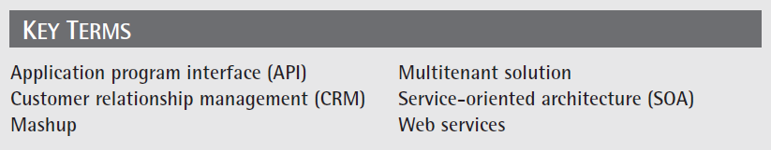
Key Terms

Slide 21
Chapter Review
Define and describe SaaS.
Discuss an SaaS provider for each of the following:
  Sales and customer relationship management
  Accounting
  Income tax filing
  Web-based meetings
  Human resources
  Payroll processing
  Backup automation
  Office document creation
  Social networking

Slide 22
Chapter Review Continued
Define and describe mashups.
List the advantages and disadvantages of SaaS solutions.
Describe the role of OpenSaaS.
Compare and contrast a web service and an SaaS solution.
Define and describe SOA.

